Slide 2
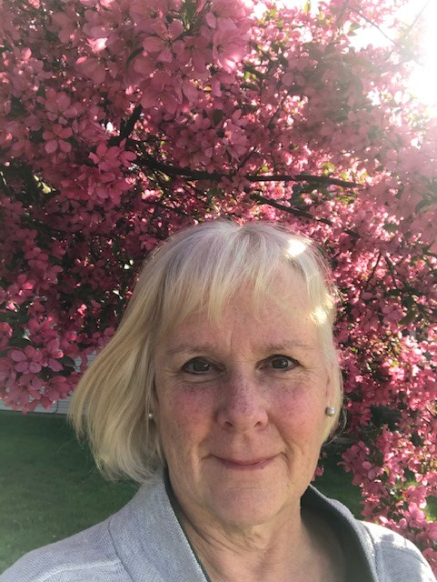
Passionate about Early Childhood!
Kindergarten Teacher, 15 years
Building Administrator, 3.5 years
Director of Outreach and Professional Development, 9 years
National Board Certified as Early Childhood Generalist
Why? ALL of our youngest learners deserve the very best we can offer them!

Slide 3

Understanding and Responding to Behavior Through the Lens of Trauma, Stress, and Self-Regulation in Early Childhood
Diane Pike, St. Mary’s Child Center
Director of Outreach and Professional Development
A Collaboration with St. Mary’s Child Center and
Dr. Lori Desautels
Assistant Professor, College of Education
Butler University

Slide 4
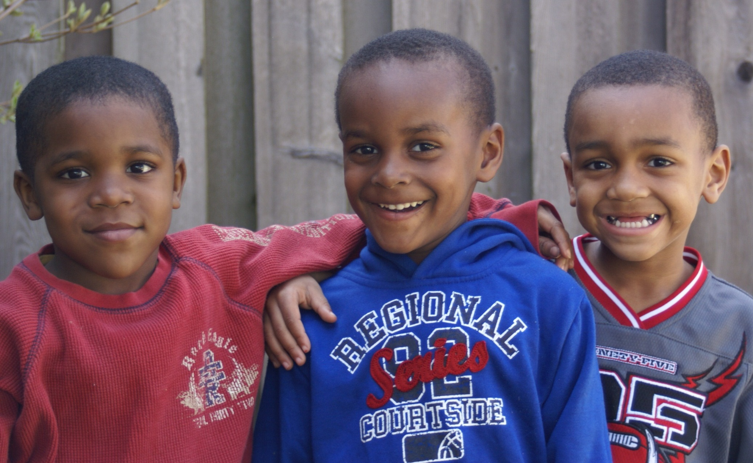
Photo by St. Mary’s Child Center
Notes:
I would like to give you some context as we begin today. It’s important for you to know a bit about St. Mary’s and how we came to this work of Applied Educational Neuroscience. The mission of SMCC is to serve children in poverty. 93% of our students come to SMCC on scholarship, either from CCDF, OMWPK, or St. Mary’s scholarship. We raise 1.5 million a year to make this happen, because these children deserve it! Marian Wright Edelman, a strong black woman who is founder and president of the Children’s Defense fund, came to Butler University several years ago, sharing a very impactful presentation. One of the things that really struck me, as well as staff of St. Mary’s, was when she shared some statistics of poor boys of color; she noted that they enter the cradle to prison pipeline at the moment of their birth, through no fault of their own. How can this be? This prompted much discussion at SMCC, and this photograph was actually taken the next day. Connie, our Executive Director, would tell you that the whole week, everywhere they looked they saw groups of boys together, and as you look at this picture, how painful is it to ask the question…”Which one of these will go to prison?” After much discussion, the staff came to understanding that this is NOT the fate of OUR students, because they have been to a high quality early childhood program. Marian Wright Edelman stated that this is 1 of the main ways to mitigate the effects of poverty! The program must be high quality. Usually, children in poverty enter school a year to 2 years behind their peers; our data shows that 83% of our students enter kindergarten ON GRADE LEVEL. We consider that a win, for sure!

Slide 5

The Pedagogy of Listening, Carlina Rinaldi
Photo by Diane Pike
Notes:
The staff of St. Mary’s has been studying the Reggio philosophy since 1999. We believe it embodies best practices and honors the child in a most respectful way. Many times I have heard people discussing the disrespect found in schools these days, and that if students were taught to be respectful in school we wouldn’t have these issues. The best way to teach respect is to BE RESPECTFUL, and that is exactly what happens in our school! We honor the Image of the Child, watching and listening so we can best follow their lead in learning. Children are natural born scientists and explorers – we nurture this and encourage it! At St. Mary’s Child Center, our goal is to have the child’s “voice” louder than the adult voice. Rather than the adult telling the child what to do, when to do it, and HOW to do it, we set out provocations and then follow the child’s lead. I could literally talk ALL day about this topic, so let me know if you would like to hear more another time!
The coming slides are documentation of an early childhood educator and a toddler in a preschool in Reggio Emilia. I wanted to share this today because I feel it shows us the brain in action – connections are being made. Children are truly brilliant!

Slide 6
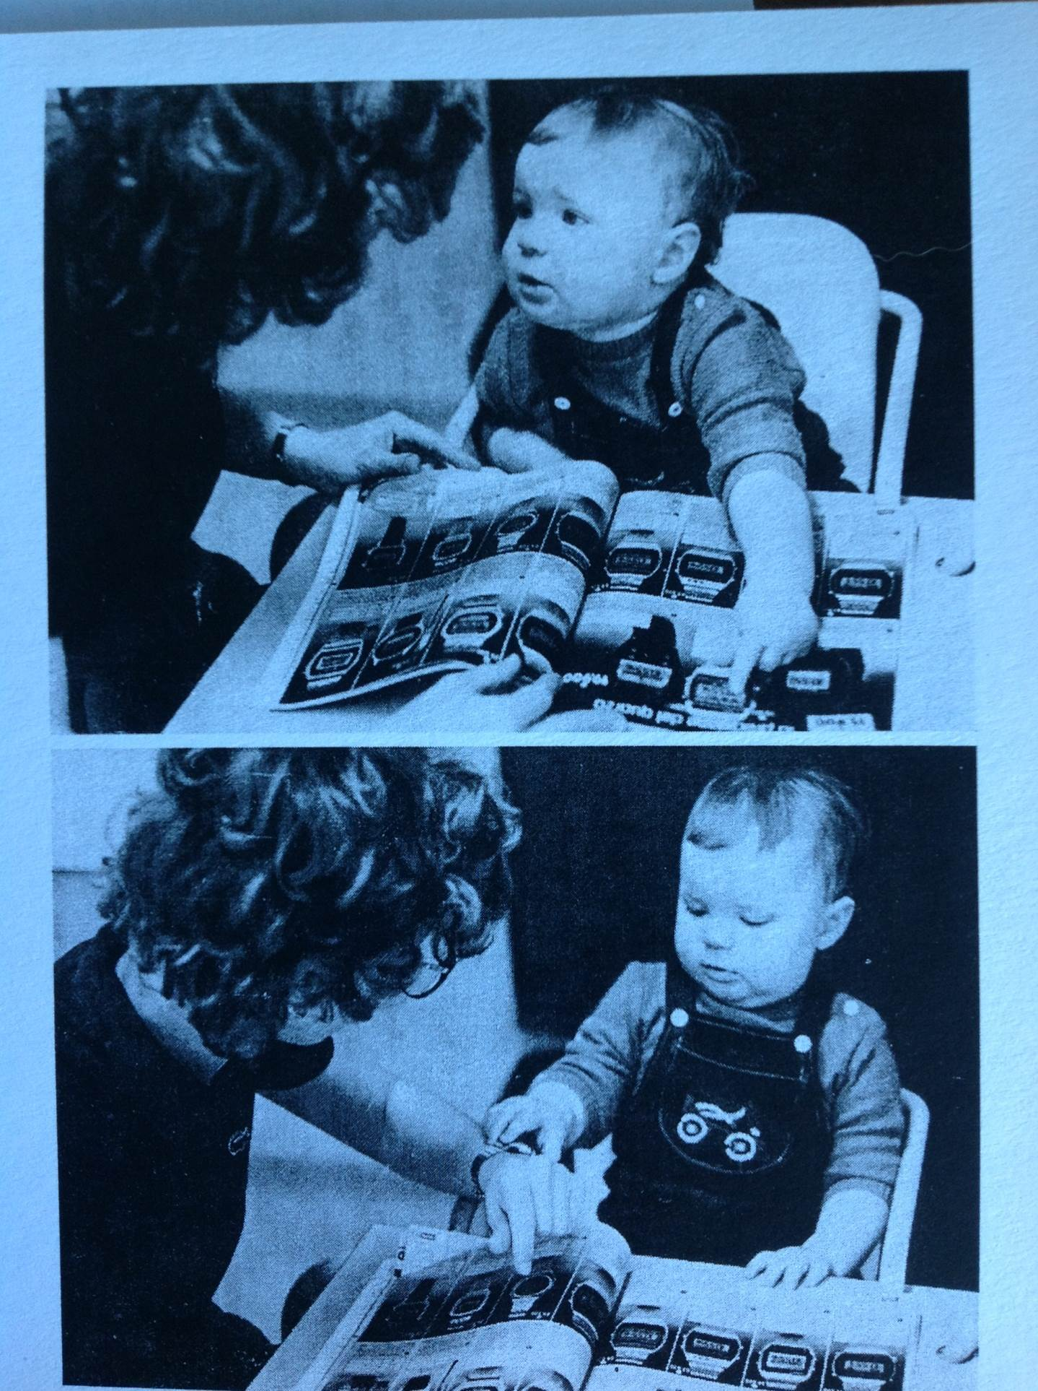
Photo from The Hundred Languages of Children
Notes:
Here, the child is looking at a catalogue of wrist watches with his teacher.

Slide 7
Photo from The Hundred Languages of Children
Notes:
The teacher allows the child to investigate her watch...

Slide 8
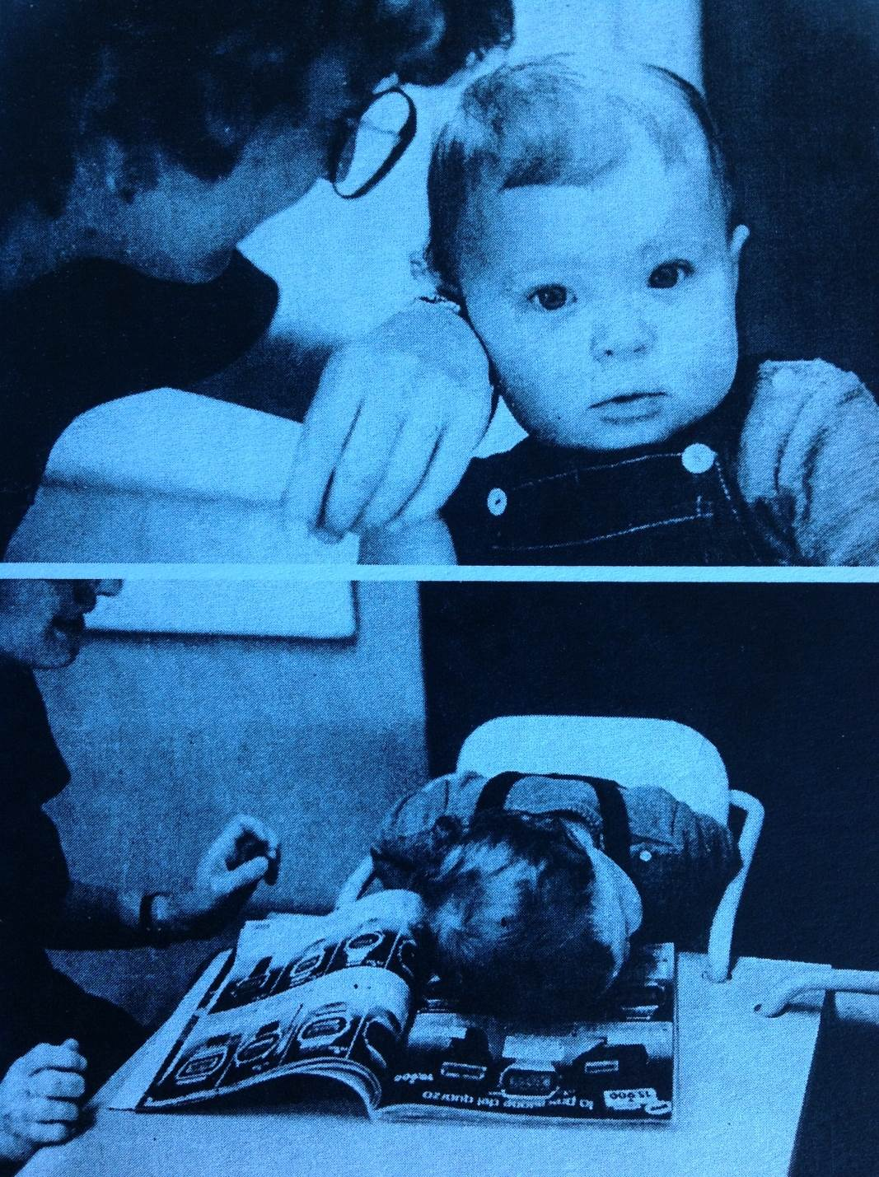
Photo from The Hundred Languages of Children
Notes:
She then encourages the child to listen to the sound of her watch (obviously, it was not digital!). The next slide shows a neural connection being made...

Slide 9
Photo from The Hundred Languages of Children
Notes:
The child bends down to listen to the watch in the catalogue – brilliant! Children are natural scientists, curious about the world around them. EVERYTHING is new to them, and as early educators, we have the privilege of seeing the world through their fresh eyes!

Slide 10
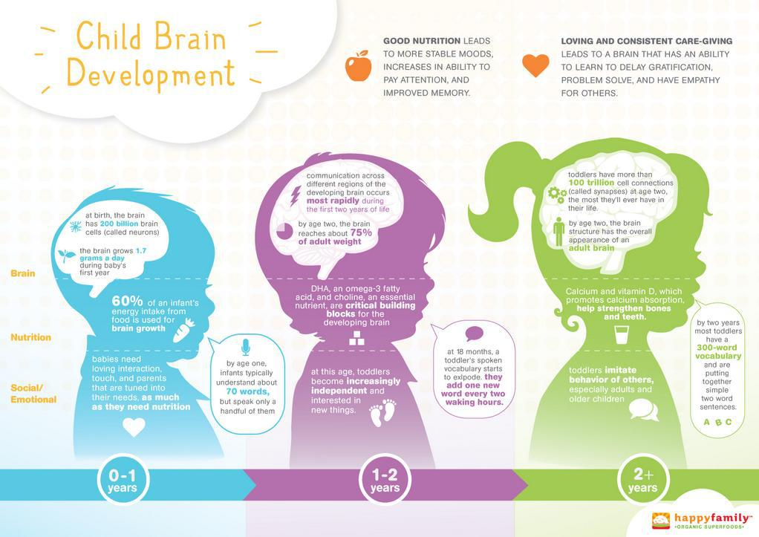
Brain Development
Notes:
At birth, the brain has 200 BILLION brain cells! During the 1st year of life the brain grows 1.7 gms/day. Babies need loving interaction, touch, and parents who are tuned into their needs as much as they need nutrition!
By age 2, the brain reaches about 75% of adult weight. Toddlers have more than 100 TRILLION cell connections by age 2 – the most they will have in their life! This is greater than a college student, due to “pruning” the brain does most rapidly from age 2 through age 16. This pruning actually continues into early adulthood, at a slower pace. The more stimulation received for a particular skill or interest, the stronger the synapses that are formed. This is why a child who is good at playing a musical instrument or certain sport, if not encouraged to continue honing those skills, will lose synapses or connections which enhance their ability at a particular age.
At this time, the brain structure has the overall appearance of an adult brain!

Slide 11
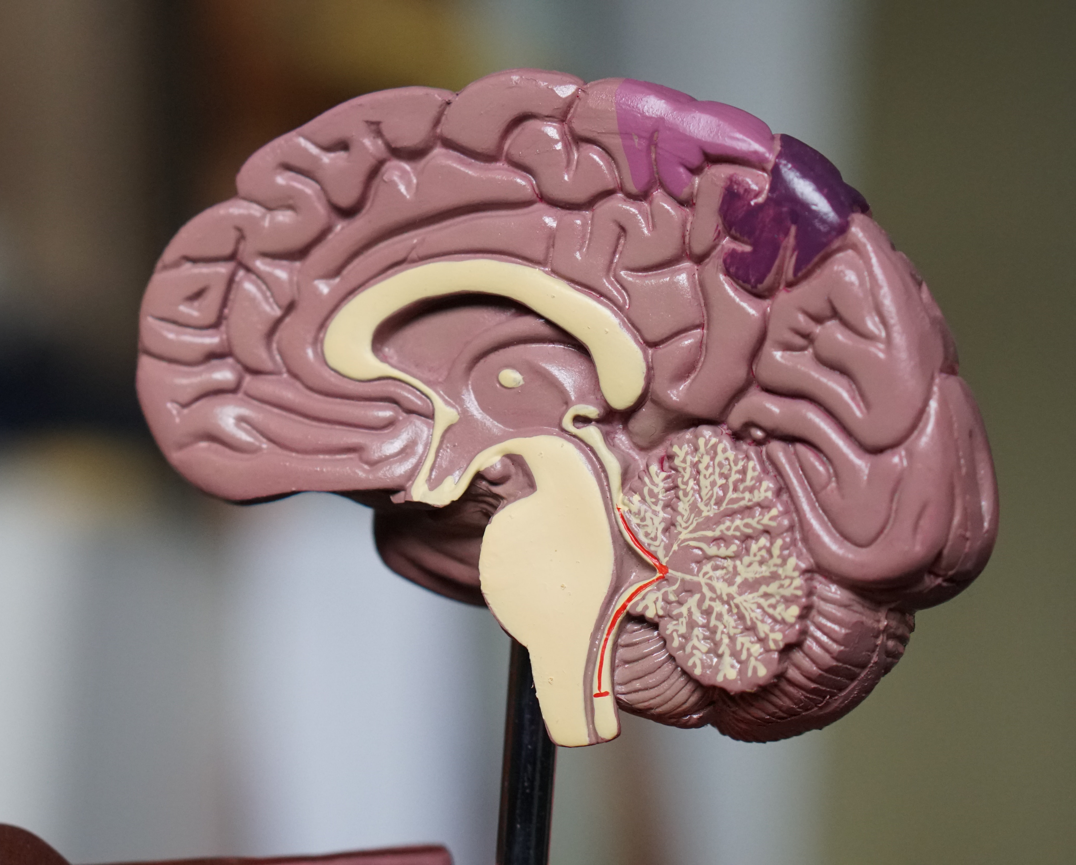
Brain Development
Photo by Robina Weermeijer on Unsplash
Notes:
The brain develops from the back to the front, and from the inside out. When adversity forces us into a state of survival, the flight or fight response takes over. For many students, there are NO circuits built for sharing, empathy, or kindness, because their experiences haven’t taught them those things! ***Experiences and the environment GROW brains!

Slide 12


Applied Educational Neuroscience
This is a Framework, not a Program
We look at both Educator and Student brain states
We meet Students where they Are
We sit beside our students in RELATIONSHIP and DEVELOPMENT
Teach Coping and Self Regulating Skills through Developmental and Brain Aligned Discipline
“Relationships are the agents of change and the most powerful therapy is human love” -Dr. Bruce Perry

Slide 13
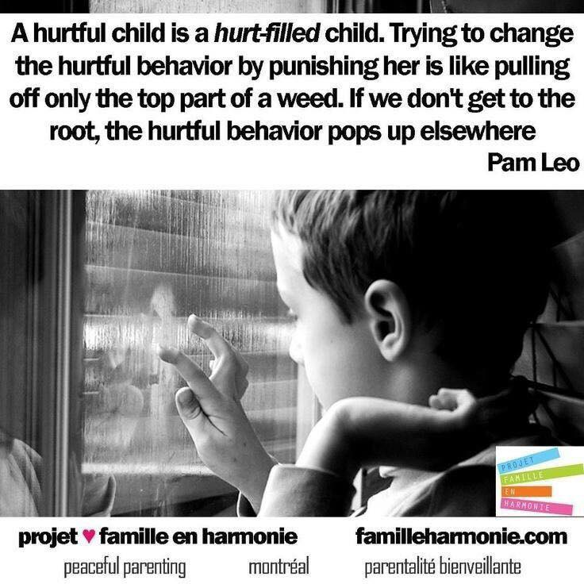
Discipline and the Brain
Traditional Discipline works best with children who need it the least!
We need a New Lens!
Notes:
At SMCC, we have always used positive discipline with our students. It is our job to teach the children appropriate behavior in this place called “school!” When a child doesn’t know something in math, we teach them. When a child doesn’t know how to read, we teach them. When a child doesn’t know how to play basketball, we teach them. Why, then, would we punish rather than teach when it comes to social/emotional development? That just doesn’t make sense!

Slide 14
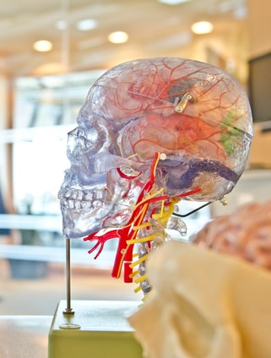
Neuro-Development and Neuro-Regulation
Photo by jesse orrico on Unsplash
All Behavior is communication!
Attachment is the carrier of all development
We must meet the student in their brain development, not academically
Life Disruptions adversely affect the structure and function of the brain
Photo by Jesse Orrico on Unsplash
Notes:
A child that is dysregulated, in the midst of a tantrum, is not going to be able to digest how to make a pattern or identify colors! We need to calm the amygdala and meet the child where they are in brain development before we move to academics!
****adversity and the stress response affect the actual biology of the brain and body!***

Slide 15

Resiliency Touch Points
--Dr. Bruce Perry
Photo by Stephanie Frosch @Steph Frosch
Notes:
When we know a student is experiencing stress and adversity, it is important that we, as a school respond by connecting with that student. It could be 30 seconds, or 5 minutes – a verbal exchange with validation, giving a smile/noticing a smile. Dr. Perry discusses “dosing” a child with experiences and social interactions that create connections. THAT will contribute to healthy brain development!

Slide 16
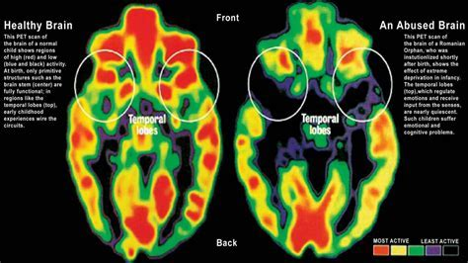

Neuroplasticity = Hope
                Photo by onesky.org
Notes:
Scientists used to think that a traumatized or neglected brain was doomed for life. Research shows us that the brain has neuroplasticity – with meaningful relationships and strategies to calm the amygdala, neural connections CAN be made! It just takes time, and a caring adult.

Slide 17
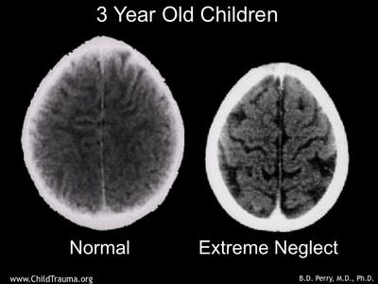

Slide 18
Strategies and Interventions/ Brain and Developmentally Aligned!
Smiling eyes
Validating eye contact
Warmth of voice
Playful engagement
400 repetitions to get one new synapse in the brain
12 repetitions if they are accompanied by joy and a little laughter!

Slide 19
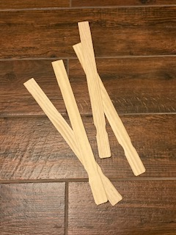
Rhythm Sticks
Photo by Diane Pike
Notes:
Explain how Dr. Lori came into the picture for SMCC; rough year – more runners; naptime was particularly difficult; saw her TED Talk, recommended from dear friend, Dr. Ena Shelley from Butler…then I found her in the parking lot of school 60!
Importance of teaching these strategies when students are calm, in small groups is best
***Working to move our students to self-regulation; first step is CO-REGULATION with an adult/peer
NOT a set of when this happens, do this, etc. …needs to become a part of your school culture, part of your being that is interwoven throughout the day

Slide 20

Blowing Bubbles
Photo by Diana Orey on Unsplash
Notes:
As we begin to view a few videos, I would like you to pay close attention to the expressions on the children’s faces; did you notice any transformations in the children as they participate in the activities?
What if they are doing it “too rough?” That’s what the child NEEDS at the time!

Slide 21

Coping and Self Regulating Skills
Singing Bowl
Photo by Magic Bowls on Unsplash
Notes:
Teacher reflection: Monica is really improving in the morning at drop off. On Monday she was sad to leave mom, but allowed me to comfort her on my lap. She really responds to the singing bowl and stops crying so she can hear the sound it makes. She is very interested in the sound and when I sing along with it.
Today at arrival Monica had very few tears. Upon arrival I was ready with the singing bowl and she nodded “yes” in response to asking her if she wanted to help me wake it up. She sat with me and wanted to help it sing.
Later in the morning she went to the bowl to try it by herself.

Slide 22

Lavender
Photo by Sharon McCutcheon on Unsplash
Notes:
Use it for our laundry – little boy wanted to wait on going to the restroom because he liked how our clothes smelled better than his!
We also put it on a cotton ball in a ziplock bag for children to carry it around in their pocket if they’d like.

Slide 23
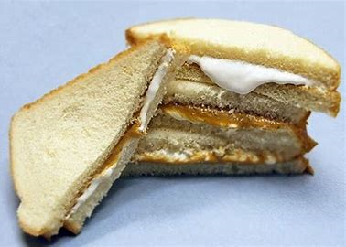
Peanut Butter Sandwich
Image from Unsplash
Notes:
Power of compressions
Older students : weighted blankets, deep pressure on arms/legs…

Slide 24
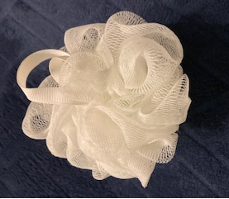

Brain Bath
Photo by Lindsay Lyon on Unsplash
Photo by Diane Pike
Notes:
Start as a short routine, then can get longer. Started short, added on in next visits
Older children can make their own routines
We encouraged teachers to jot down reflections as they incorporated the strategies on their own, as well as take photos. When this strategy was 1st introduced, 1 child spoke up, very concerned that he didn’t want to get his clothes and new shoes wet in the bath!
A teacher wrote: We first used the loofah to squish and make bubbles. She almost “melted” when I dried her off. You could immediately see a difference in her brain state after the “brain bath.”

Slide 25
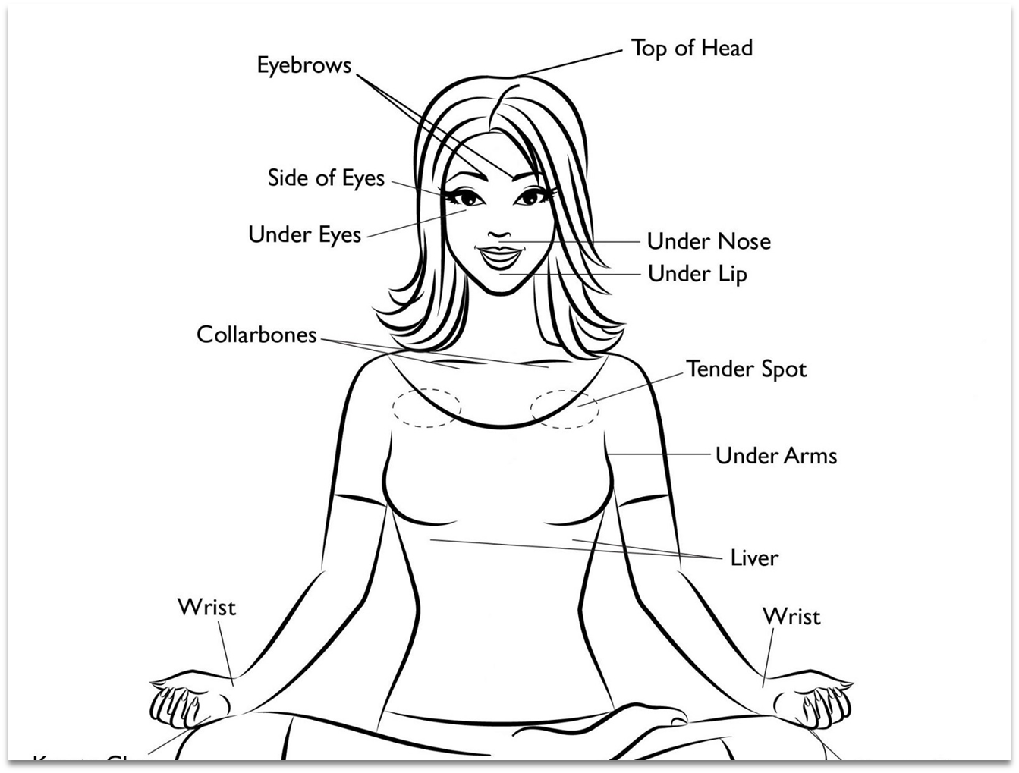
EFT Tapping
Photo by Evelyn Lim
Emotional Freedom Technique
Notes:
“The cause of all negative emotion is a disruption in the body’s energy system.” – Gary Craig, Founder of EFT Meridian or EFT tapping is an easy-to-learn yet effective healing system that is best described as applying the ancient art of acupuncture but without the needles. It involves using the finger tips to tap on specific meridian points on your face and body. It combines ancient Chinese acupressure and modern psychology to deliver astonishing results.
Let’s tap together now! After learning the technique, SMCC Leadership team were all tapping during a few stressful meetings!
ORDER doesn’t matter
Do NOT haver to do each point
Students can lead

Slide 26

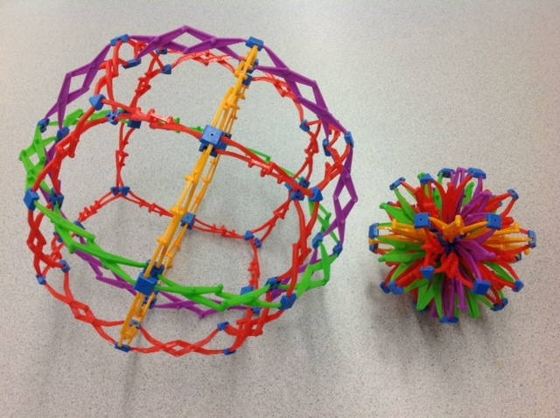
Breathing Techniques
Photo by
yang miao@yangmiao
Image from theselfregulatedteacher.files.wordpress.com

Slide 27
But what about the Educators?
…a dysregulated adult cannot regulate a dysregulated child!

Slide 28
We must consider Co-regulation as a way of being, NOT just a strategy
Coercive Regulation is the more traditional discipline thought process:
Teacher Control
No self-awareness
Make the child feel uncomfortable because of their behavior
Focus only on child’s behavior which at times feels disrespectful to the teacher
No thought of child’s needs
Teacher is looking for compliance
Teacher brain state is not regulated, and the teacher often gets caught up in a negative exchange with the student
Co-Regulation:
Teacher is aware of own feelings
Focus on child’s feelings not the behavior
Teacher will take a second to calm before words come out
Teacher will model regulation strategy for the child such as deep breathing or jumping jacks – whatever strategy is best for the situation
Teacher will focus on keeping their brains state steady during the emotional challenge
        Desautels; Creating Trauma informed instruction)
Notes:
Give them a few minutes to read before I start talking!
Teacher control and COMPLIANCE vs. Focus on Child’s FEELINGS - NOT the behavior!
“Disrespectful” activity vs. modeling calm behavior….sit beside and rock/hum/tap

Slide 29
There must be a shift from Trauma Informed to Trauma Responsive
Working intensively with staff will help those who are hesitant to understand why we do this with children (NOT rewarding children, but helping them become regulated)
Staff need to know it’s OK to ask for help: awareness that they are dysregulated; they need to know where to turn when they need a moment; put a plan in place
It’s all about relationships – just like it is with the children
Notes:
Give them a few minutes to read before I start talking!
LEADERS need to be prepared to calm the STAFF…What triggered me as an adult?
How can I make this a SAFE place for the adults, as well?

Slide 30
St. Mary’s Teacher Wellness Plan
Notes:
We created a Self-Care contract for our staff. You can find it in the resource list.
For those of you working with older students, the strategies listed could be very helpful for them to regulate.

Slide 31
Self-Care Checklist:
Take care of yourself FIRST
This week I will plan to add or change _____ strategies for self-care.
Today did you? (Check 1 or more)
Take a break when you need one | Drink more water | Do one thing you love
Create positive self-talk | Turn off your phone | Get enough sleep
Treat yourself | Do some belly breathing | Play calming music
Leave paperwork at school | Say, “Thank You.” | Talk to a friend
(add your own) | (add your own) | (add your own)
At the end of the day we are all human! The goal is to become more brain aligned.
Our children NEED the best from us every day!
Notes:
This self-care checklist is the same idea; you can find it in the resource list.
Choices that adults/older students can access to help with regulation

Slide 32
Resources
Edwards, Gandini, Forman, The Hundred Languages of Children
Dr. Lori Desautels, Materials from Butler AEN Certification and her website: www.revelationsineducation.com
Dr. Lori has 2 sessions On Demand on this website, 90 minutes each!
Dr. Lori’s books are excellent resources, as well!

Slide 33

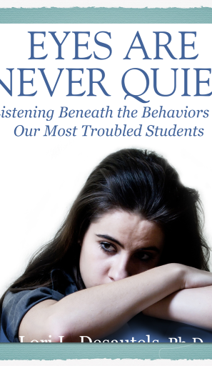


Slide 34
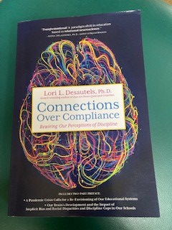

Slide 35
Thank You!
Visit KeepIndianaLearning.org for more professional learning opportunities.
Diane Pike
St. Mary’s Child Center
Director of Outreach and Professional Development
dpike@smccindy.org
Twitter Handle: @dpike03_pike
Notes:
This recording will be posted in the On Demand section of the Keep IN Learning website in the coming weeks. If there are colleagues you thought of as you watched this today who you think might benefit from the information, please encourage them to check it out! In addition, I will be doing another 30 minute recording on the topic of applied education neuroscience, challenging behaviors, and discipline. This will also be available in the On Demand section in the coming month or so.

Slide 36
Connect With Us!
Diane Pike
Director of Outreach and Professional Development
dpike@smccindy.org
(317)361-4894
Connie Sherman
Executive Director
csherman@smccindy.org
(317)361-4868
St. Mary’s Child Center
http://www.smccindy.org
Dr. Lori Desautels
https://www.facebook.com/lori.l.desautels
Desautels_phd
ldesaute@butler.edu
www.revelationsineducation.com
Desautels_phd - twitter handle
To understand our neurobiology is to know the secret of life!

