Slide 2
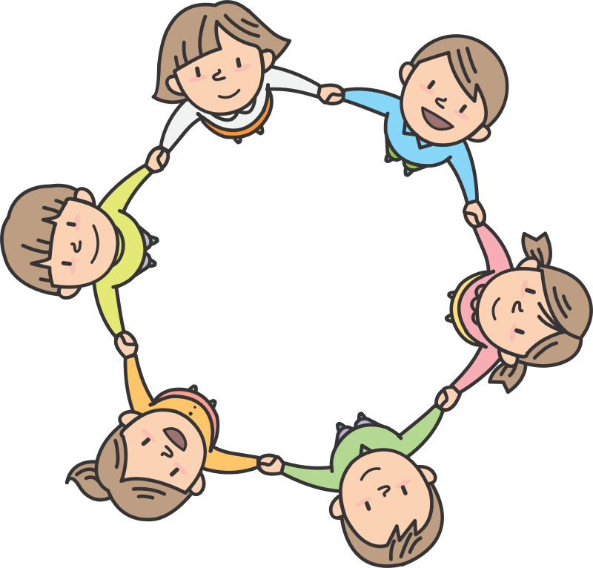
The Power of Community Circles
Morning Meetings and Closing Circles:
Principal and Teacher Perspectives
Clip art from Open Clip Art

Slide 3
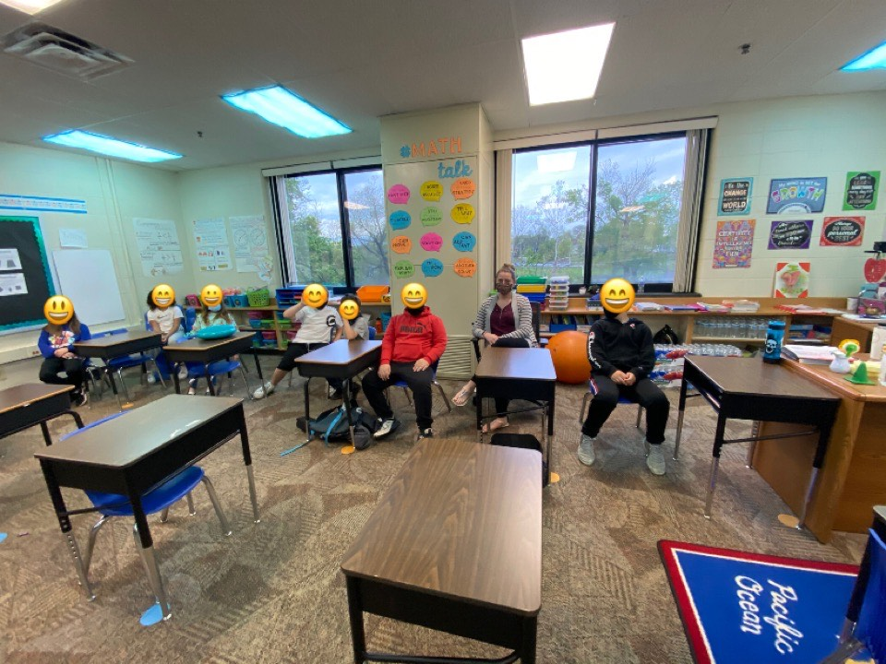
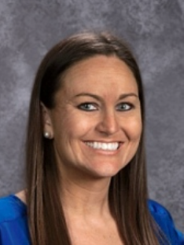
Our Panel Discussion

Slide 4
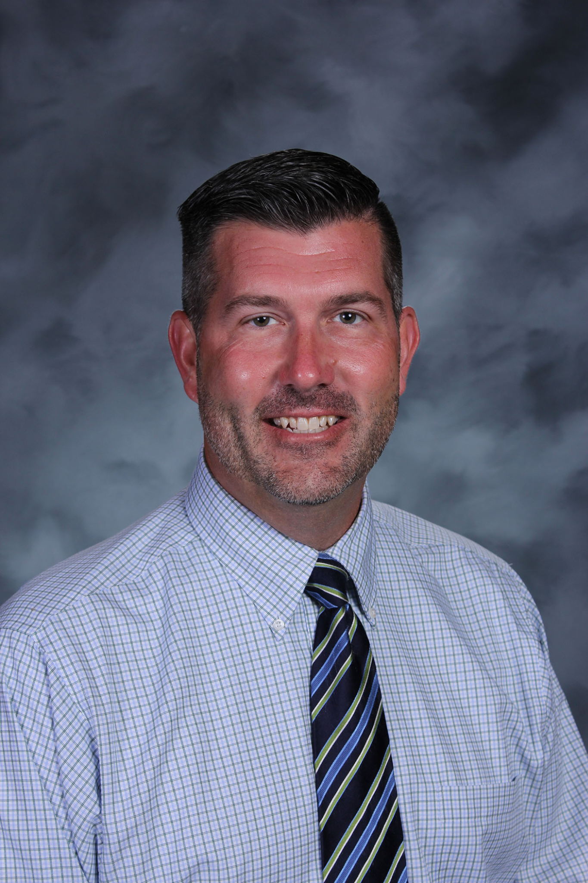
Four Years of Community Circles
Began morning meetings during school year 17-18
Our principal at the time was Craig Buckler
Ms. Cotter was a classroom teacher at the time.
  Before, during, and after morning meetings

Slide 5
Teacher Perspective
How are morning meetings helpful to your students and your classroom environment?

Slide 6
Teacher Perspective
How are morning meetings helpful to you?

Slide 7
Principal Perspective
How much time is devoted to morning meetings?
How do you structure the day to make time for morning meetings?
Why do you give up classroom instruction time for morning meetings?
How do you protect the time for morning meetings?

Slide 8
Principal Perspective
What impact do you see the morning meetings having on students, teachers, and the climate of the school?

Slide 9
Teacher Perspective
What supports were in place for you to do morning meetings during the first year of implementation of morning meetings?
How important was it to you the first year of implementing morning meetings to have these supports in place?

Slide 10
Closing Circles
The next year we implemented closing circles. Craig Buckler was still our principal at this time.
Principal perspective
  How much time do you devote in the schedule to closing circles?
  Why have you continued closing circles?
  How do you help teachers with finding time at the end of the day for closing circles?

Slide 11
Closing Circles
Teacher perspective:
How do you find time in the chaos of the end of the day to do closing circles?
What do you like about doing closing circles?

Slide 12
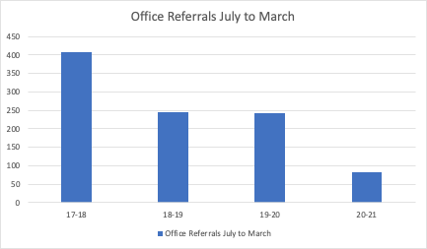
Data--Office Referrals

Slide 13
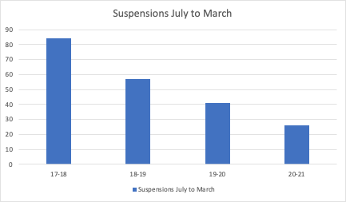
Data--Suspensions

Slide 14
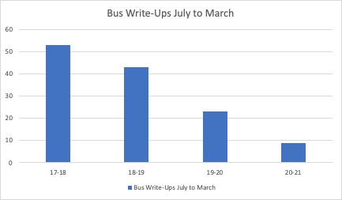
Data--Bus Write-Ups

Slide 15
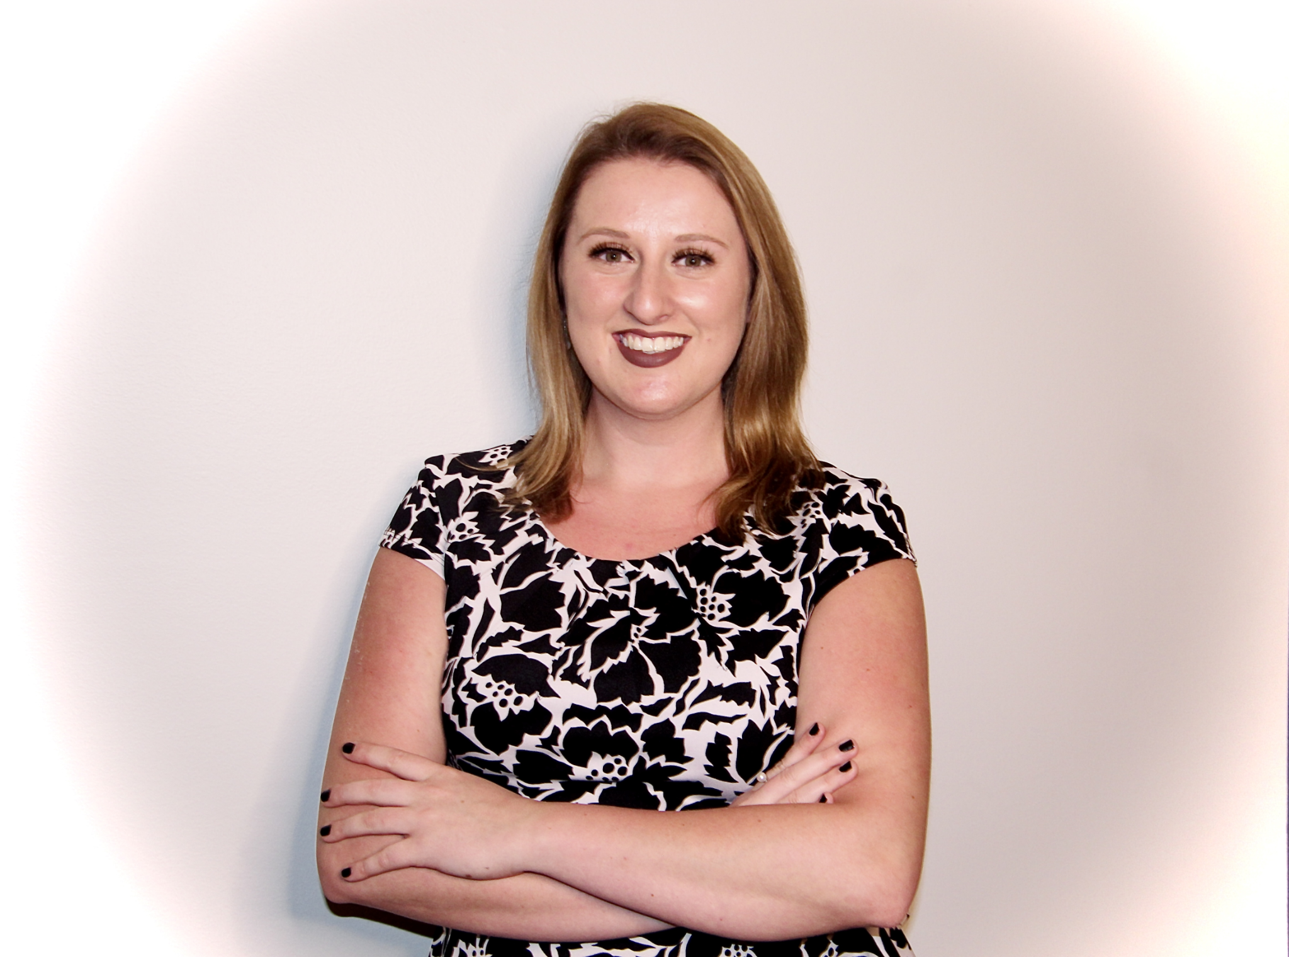
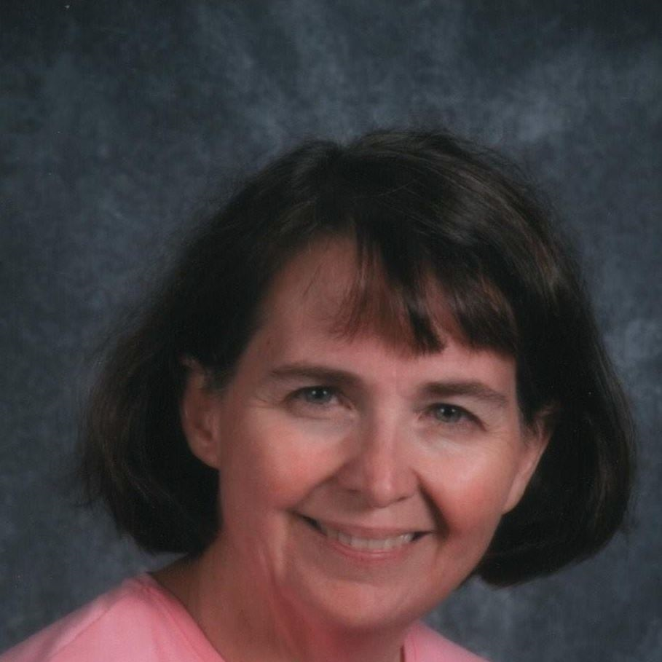
Stephanie Cotter
scotter@bgcs.k12.in.us
Crystal Majors
cmajors@bgcs.k12.in.us
Trudi Wolfe
twolfe@bgcs.k12.in.us

Slide 16
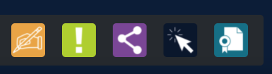
Thank you for attending
Please complete the short feedback survey on the screen.
Don’t forget to download your PGP Certificate from the webcast toolbar.
Notes:
Make this the last slide in your presentation

