Slide 2
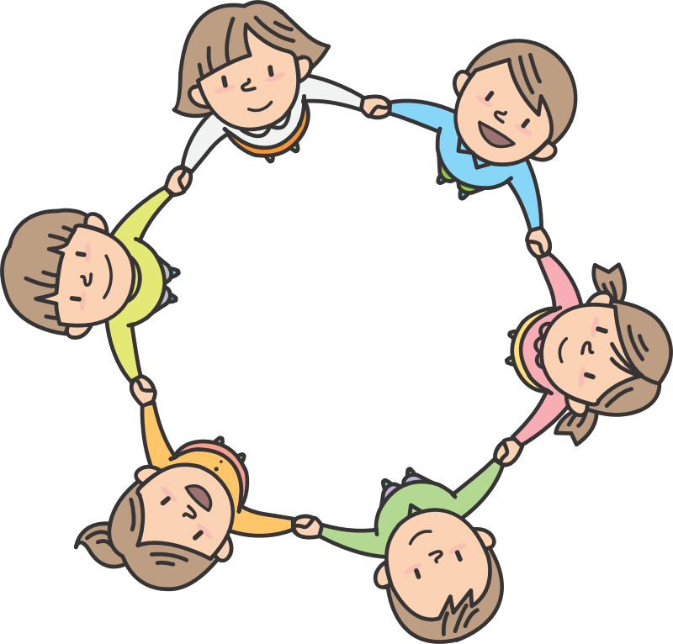
The Power of Community Circles
Morning Meetings and Closing Circles: Purpose and Implementation
Clip art from Open Clip Art

Slide 3
Why Do Community Circles
29% of school-age children diagnosed with depression or anxiety | 20% of children live in homes with toxic stress
10-20% of children are exposed to domestic violence | 37% of children will have a CPS investigation of their families before they turn 18
IN has second highest rate of child abuse in the nation. | IN ranks 3rd out of 36 states in the percentage of HS students who seriously consider suicide.

Slide 4
Why Do Community Circles
26% of children in US will witness or experience a traumatic event before they turn 4 years old. | 60% of adults say they experienced abuse or other traumatic family events during their childhood
1 in 4 girls will be sexually abused before age 18. | 41% of youth under 18 reported experiencing a physical assault in the last year
14% of children have experienced physical abuse by a caregiver during the past year. | 70% of children living in poor inner-city neighborhoods are exposed to trauma.

Slide 5
Why Needed: Brain (Amygdala)
Part of the limbic system
Always scanning the environment, asking “Am I safe?”
When activated, the prefrontal cortex goes off-line.
Stress hormones released
Fight/flight/freeze response

Slide 6
Beginning
Climate in our school through last 16 years about understanding social-emotional needs of students:
Not want to hear
Hear, but “still have to pass ISTEP.” (test at the time)
Hear, “but we can’t let them make excuses.”
Hear and change what we do to support students

Slide 7
How We Got Here
TAP
Focus on positive
Tone of voice
Impact on student
PBIS
Focus on positive
Tone of voice
Reward System
Lilly Grant
Focus on SEL
Mindfulness
Relationships

Slide 8

I Wish my Teacher Knew…
Book study on book I Wish my Teacher Knew: How One Question Can Change Everything for our Kids by Kyle Schwartz.
Image from publisher:
De Capo Lifelong Books

Slide 9
Scheduling
Need to be committed to the need for this intervention. The time “lost” during morning meetings is gained by the reduction in time needed to address behaviors.
Determine how much time needs to be spent on morning meetings.
Look at the Related Arts schedules, lunch and recess times, and transitions
Build the daily schedule around the morning meeting time rather than trying to “fit it in.”
If needed, add minutes to the school day.

Slide 10
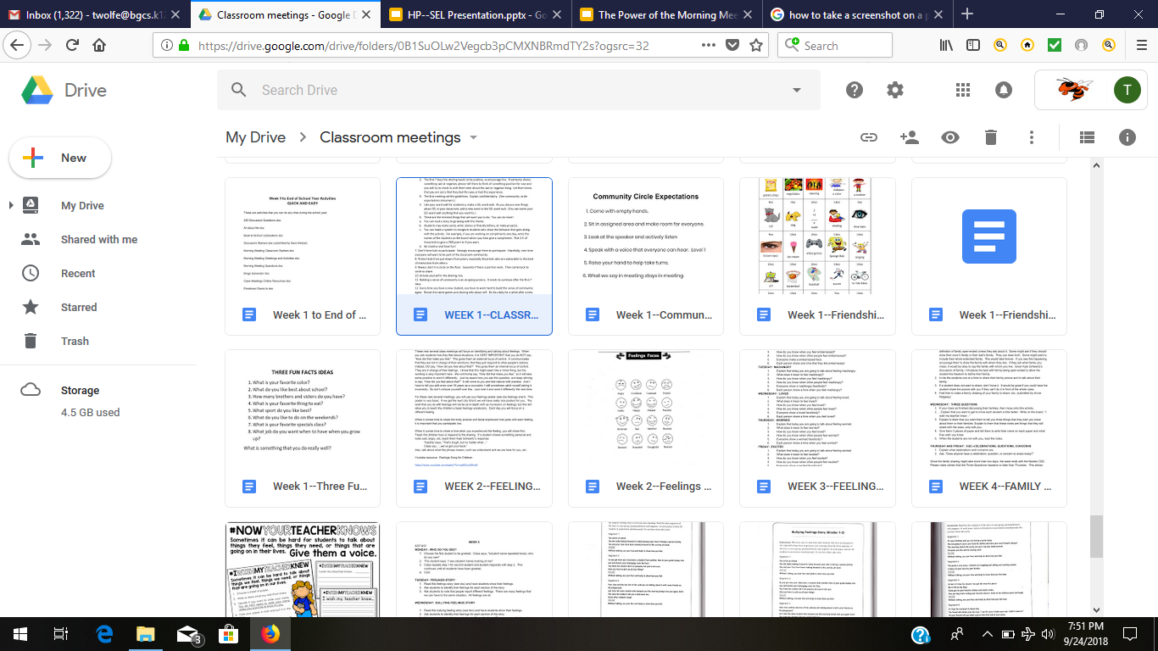
Structure

Slide 11
How to Get Teachers on Board
Use the research to provide education on the need for this intervention
Connect intervention to the needs of the students. Help teachers understand the needs of the students. (PDs and book study)
Include teachers in the discussion and development of this intervention
Model for teachers how to do the meetings through before implementation
Morning meetings need to be supported by all staff.
Materials and activities (curriculum) need to be provided to teachers.

Slide 12
Research to Help Get
Teachers on Board
“The Four Social-Emotional Conditions for Learning:
  Safety
  Support
  SEL--manage emotions and relationships positively
  Engagement and challenge in learning”
National Clearinghouse on Supportive School Discipline: The Four Social-Emotional Conditions for Learning (https://supportiveschooldiscipline.org/conditions-of-learning)

Slide 13
Research to Help Get
Teachers on Board
“Research shows that when we connect with others through reflective communication that it stimulates activation and development of the prefrontal cortex part of the brain.”
Daniel J. Siegel, M.D.,
Brainstorm: The Power and Purpose of the Teenage Brain (pg.209)

Slide 14
Support Teachers Need
Information about why morning meetings are important to do
A structure for the meetings
Support with the presence of other staff--IAs, Related Arts, Title teachers, principals

Slide 15
Principal’s Involvement
Attend and participate in all trainings
Provide funds for materials
Support grant applications
Be involved with the meetings to support teachers and to engage with students
Organize the daily schedule to accommodate the meetings
Make the meetings the expectation. It is part of the school day.

Slide 16
Impact on Students
Students say:
“It’s like we’re a family.”
“I can trust my teacher.”
“My relationship with my teacher is bigger.”
“I like talking about my feelings.”

Slide 17
Impact on Students
Research says that rituals, such as morning meetings, lower the stress hormone, cortisol, for students. Cortisol activates the fight, flight, freeze response, which interferes with learning.

Slide 18
Impact on Students
Data from Student Surveys
Have you created relationships this year with adults that have helped you be successful this school year? 3rd grade students who responded yes
2016--61%
2018--74%

Slide 19
Impact on Students
Data from Student Survey
Do you have problems getting along with your teachers?
3rd grade Black/AA students who responded yes
·
2016--55%
·
2018—17%
3rd grade Multiracial students who responded yes
·
2016--55%
·
2018--38%

Slide 20
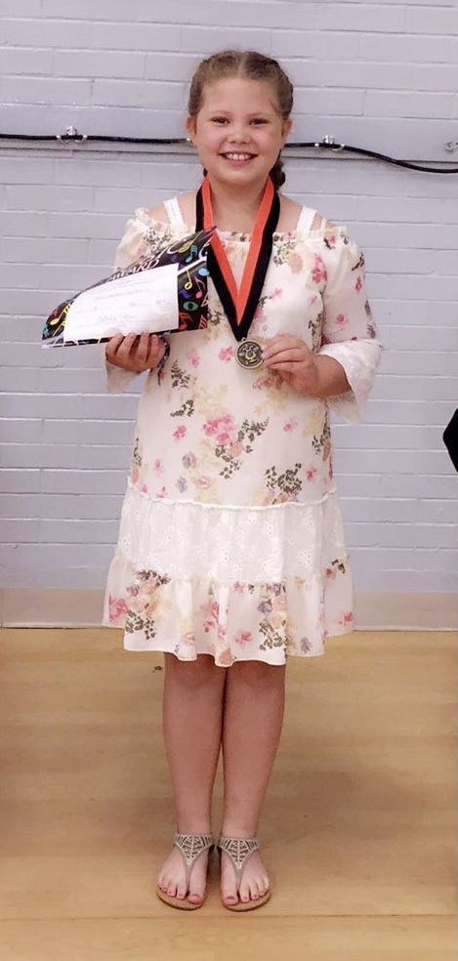

Impact on Students
Kira, 3rd-grade student during school year 18-19 shares her thoughts about morning meetings.
Community circles are like bringing your heart into the classroom.
Clip art from Open Clip Art

Slide 21
Impact on Teachers
“I have a better connection with my students.”
“Calm start to day”
“New students feel more welcomed than before.”
“Students are kinder to each other.”
“Seeing true empathy expressed.”
“Students love to share and have others listen to them.”
“I cannot imagine teaching without the morning meeting.”

Slide 22
Impact on Teachers
100% of our teachers and principals agree that morning meetings have been helpful!
Just as morning meetings lower cortisol levels for students, teachers also experience lower cortisol levels.

Slide 23

The Circle Has Power
Eye contact
Each person has value.
Sense of safety and openness
Builds sense of community

Slide 24
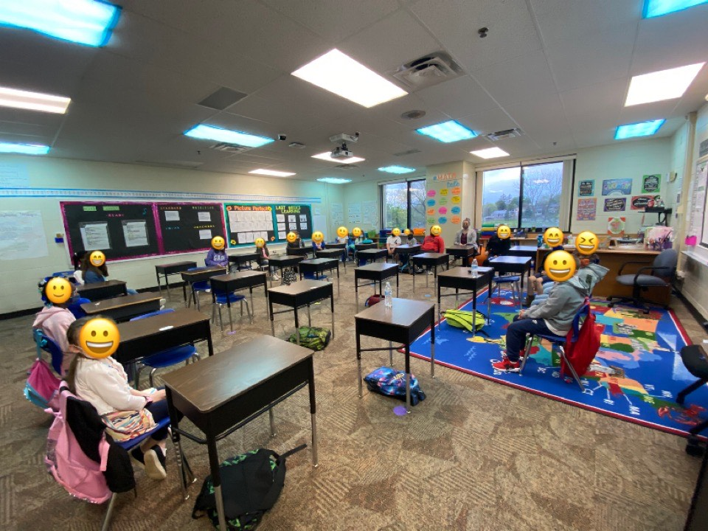
Community
Circle in a Pandemic

Slide 25
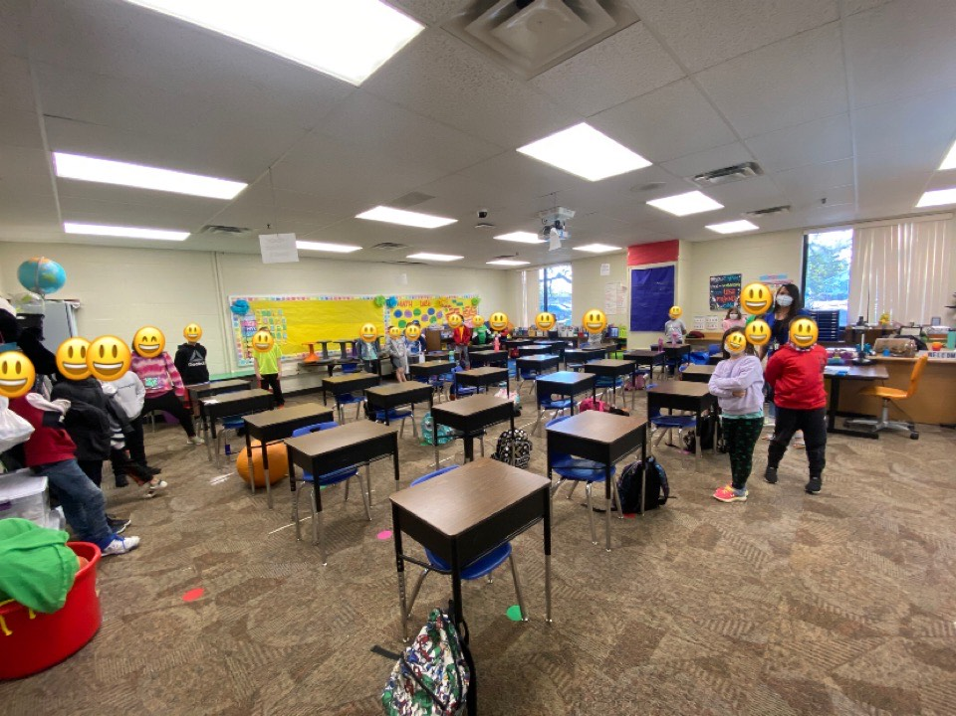
Community
Circle in a
Pandemic

Slide 26
What We Learned
Pilot with a few classrooms first
Protect time--no student is pulled out
Folder is growing document with teachers receiving credit for contributions
Counselor visit all classrooms
Small group meetings when students have difficulties
Prepare new teachers each year
Review each year

Slide 27
What Happened Next
Morning meetings have spread to K-1 and intermediate building (4-6) and to MS (7-8).
We began closing circles the following year.
We continue to look for new ideas.

Slide 28

Closing Circles
We liked morning meetings so much that we began closing circles during school year 18-19.
Image from publisher:
Center for Responsive Schools

Slide 29
Closing Circles
The challenge is getting closing circles done during the chaos of the end of the day.
Teachers need to have a plan to wrap-up the day in a structured way.
Principal needs to give teachers permission to end the academic time earlier.
Principal needs to communicate an expectation that closing circles will be done every day.
There needs to be a signal for closing circles to begin, such as starting announcements earlier to signal end of the day.
Teachers need to understand the benefit of closing circles.

Slide 30
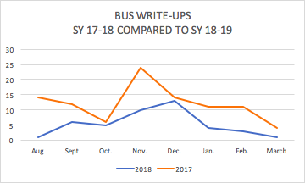
Why Closing Circles Are Worthwhile

Slide 31
Why Are Community Circles Worthwhile
Fits in with trauma-informed school approach
Fits in with brain-aligned strategies (Dr. Lori Desautels)
Sets the tone for the day
Improves climate of classroom and school
180 mini-SEL lessons for school year

Slide 32
Why Are Community Circles Worthwhile—First Year
Decrease in office referrals Sept. 2017 to Sept. 2018: 50%
Decrease in suspensions Sept. 2017 to Sept. 2018: 74%
Decrease in 2nd grade suspensions Sept. 2017 to Sept 2018: 89%

Slide 33
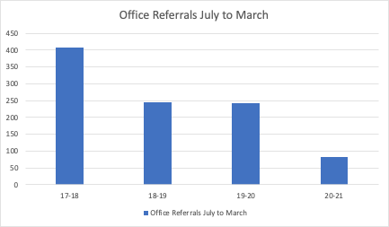
Why Worthwhile—Long-Term

Slide 34
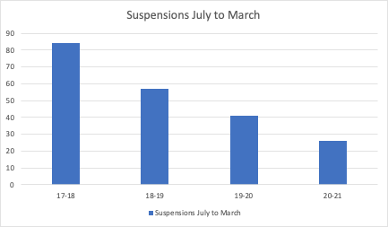
Why Worthwhile—Long-Term

Slide 35
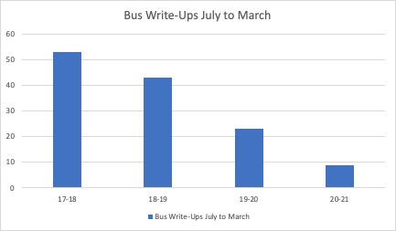
Why Worthwhile—Long-Term

Slide 36
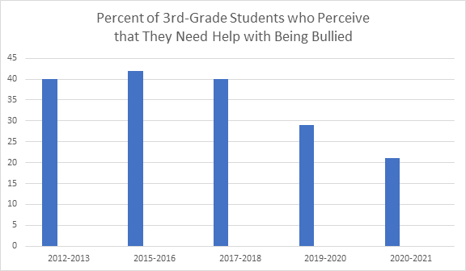
Why Worthwhile—Long-Term

Slide 37
Resource on First Six Weeks of Plans
A note about the resource for the first six weeks of plans:
The first six weeks build the “emotional literacy” that the students need to learn how to talk about their feelings
It is important to build this foundation for students to learn about their feelings and to express their feelings.
This work will also build coping skills for students.

Slide 38
Resource Page
Conditions for Learning. Supportive School Discipline. https://supportiveschooldiscipline.org/conditions-of-learning.
Creating a Culture of Trust and Safety in Every Class. (2015, August 12). Edutopia. https://www.edutopia.org/practice/morning-meetings-creating-safe-space-learning.
Dabbs, L. (2013, September 18). Edutopia. https://www.edutopia.org/blog/morning-meeting-changing-classroom-culture-lisa-dabbs.
Desautels, L. L., & McKnight, M. (2019). Eyes are never quiet: listening beneath the behaviors of our most troubled students. Wyatt-MacKenzie Publishing.
Davis, C. (2012) 80 Morning meeting ideas: for grades 3-6. Center for Responsive Schools, Inc.

Slide 39
Resource Page
Januszka, D., & Vincent, K. (2012). Closing circles: 50 activities for ending the day in a positive way. Northeast Foundation for Children, Inc.
Morning Meetings: Building Community in the Classroom. (2017). YouTube. https://youtu.be/U6_pLkwaCeY.
Roser, S. L. (2016). 80 Morning meeting ideas: for grades K-2. Center for Responsive Schools, Inc.
Schwartz, K. (2016). I Wish my Teacher Knew: How One Questions Can Change Everything for our Kids. Da Capo Lifelong Books.
Soma, C., & Allen, D. (2018). 10 steps to create a trauma informed school. Albion, MI: The Institute for Trauma and Loss in Children, a program of Starr Global learning Network.

Slide 40
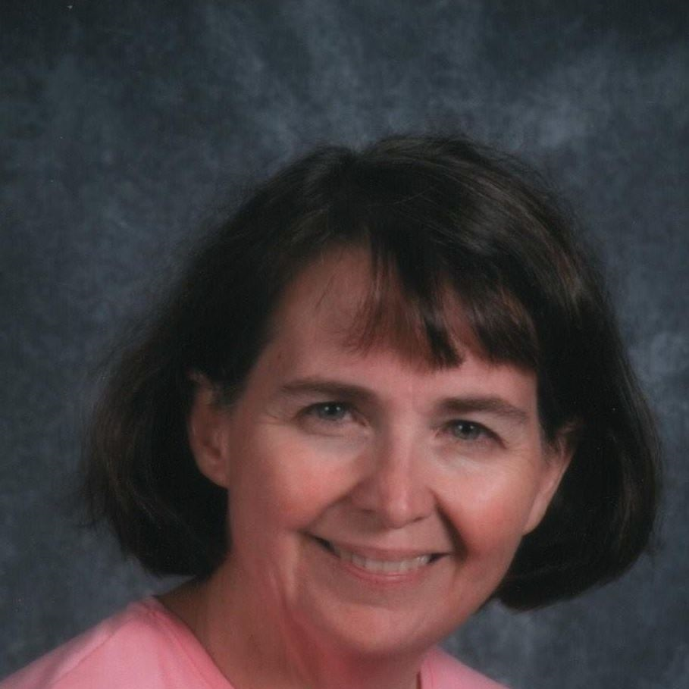
Trudi Wolfe
Central Elementary/BGCS
twolfe@bgcs.k12.in.us

Slide 41

Thank you for attending
Please complete the short feedback survey on the screen.
Don’t forget to download your PGP Certificate from the webcast toolbar.
Notes:
Make this the last slide in your presentation

