Slide 1


The What, Why, Where, & When of New Indiana Science Standards
Presentation by:
Amanda McCammon
Notes:
SS is the STEM leg of KInL. SS is a STEM-centric community of practice committed to fostering the delivery of data-informed services, including high-quality professional development, resources, and support for STEM-focused districts, programs, and organizations in an endeavor to produce a combined impact greater than the sum of separate STEM efforts.
STEM Synergy is a result of numerous partnerships over the years and is the latest iteration of the Indiana STEM Ecosystem.
This session will dive into the what, why, where and when of the new Indiana science standards that were state board approved in July of 2022. Why did Indiana adopt new science standards recently? What are these new standards about? When do I have to start using them? Where can I find high quality resources to learn more about these standards and how to implement them? Join us to get answers to these questions while providing input into how your teams would like to be supported in the future on unpacking and rolling out these standards!

Slide 2

WHO I AM
Over 17 Years in Indiana Public Education
Former Teacher, Building Administrator, CTE Director, Student Services Coordinator, & Assistant Superintendent
Former IDOE Chief of Workforce & STEM Alliance
KInL STEM Synergy Coordinator
Indiana STEM Ecosystem Lead
Notes:
Over a 17 yrs serving at all levels in Indiana education
Technology education and PLTW teacher, building administrator, CTE Director, Student Services Director, and Assistant Superintendent.
Two years at the State level as the Chief of Workforce & STEM Alliances.
Led the charge from the General Assembly in 2017 to develop a 6 year Statewide STEM strategic plan outlining Indiana's objectives for STEM education.
Served across the nation as an educational consultant working toward equitable, high quality STEM for all. Amanda also serves as the Indiana STEM Ecosystem Lead and STEM Synergy Coordinator for CIESC/Keep Indiana Learning.

Slide 3
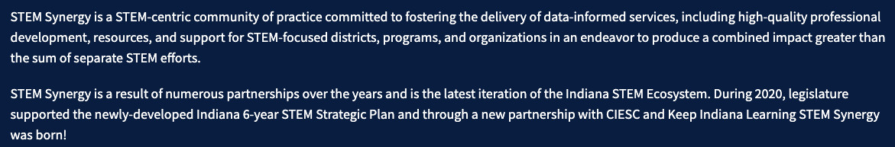

STEM SYNERGY
Notes:
https://keepindianalearning.org/expert-networks/stem-synergy/

Slide 4

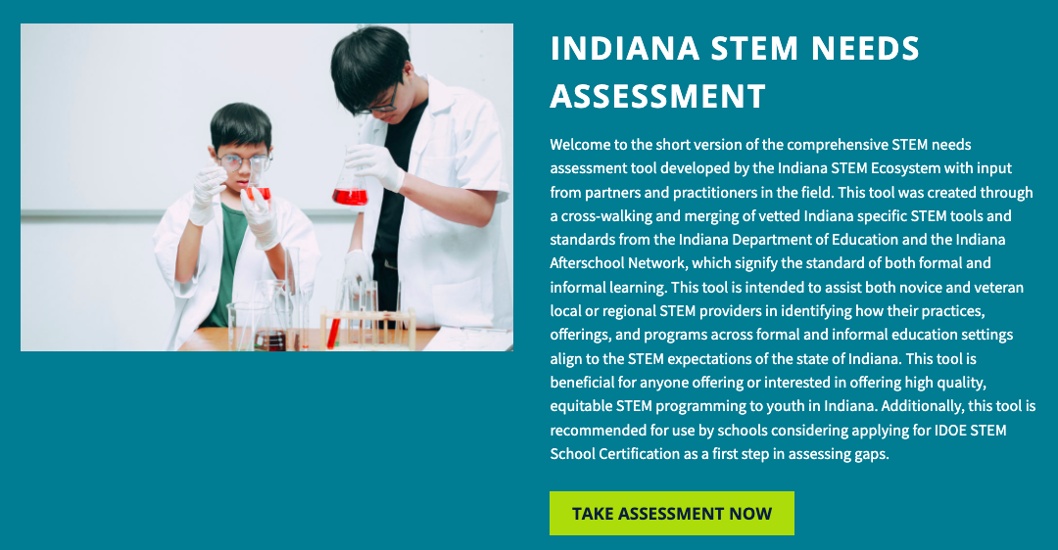
STEM SYNERGY
Notes:
https://keepindianalearning.org/expert-networks/stem-synergy/

Slide 5
TODAY’S LEARNING OUTCOMES
By the end of the session I will better understand …
…why Indiana adopted new science standards;
…what these new standards are about;
…when these new standards should be implemented and when they will be assessed; and
…where high quality resources can be found for these new standards.
Notes:
This session will dive into the what, why, where and when of the new Indiana science standards that were state board approved in July of 2022. Why did Indiana adopt new science standards recently? What are these new standards about? When do I have to start using them? Where can I find high quality resources to learn more about these standards and how to implement them? Join us to get answers to these questions while providing input into how your teams would like to be supported in the future on unpacking and rolling out these standards!

Slide 6

why
Notes:
Share in chat - https://www.nextgenscience.org/three-dimensions
Dimension 1: Practices
The practices describe behaviors that scientists engage in as they investigate and build models and theories about the natural world and the key set of engineering practices that engineers use as they design and build models and systems. The NRC uses the term practices instead of a term like “skills” to emphasize that engaging in scientific investigation requires not only skill but also knowledge that is specific to each practice. Part of the NRC’s intent is to better explain and extend what is meant by “inquiry” in science and the range of cognitive, social, and physical practices that it requires.
Although engineering design is similar to scientific inquiry, there are significant differences. For example, scientific inquiry involves the formulation of a question that can be answered through investigation, while engineering design involves the formulation of a problem that can be solved through design. Strengthening the engineering aspects of the Next Generation Science Standards will clarify for students the relevance of science, technology, engineering and mathematics (the four STEM fields) to everyday life.
Dimension 2: Crosscutting Concepts
Crosscutting concepts have application across all domains of science. As such, they are a way of linking the different domains of science. They include: Patterns, similarity, and diversity; Cause and effect; Scale, proportion and quantity; Systems and system models; Energy and matter; Structure and function; Stability and change. The Framework emphasizes that these concepts need to be made explicit for students because they provide an organizational schema for interrelating knowledge from various science fields into a coherent and scientifically-based view of the world.
Dimension 3: Disciplinary Core Ideas
Disciplinary core ideas have the power to focus K–12 science curriculum, instruction and assessments on the most important aspects of science. To be considered core, the ideas should meet at least two of the following criteria and ideally all four:
Have broad importance across multiple sciences or engineering disciplines or be a key organizing concept of a single discipline;
Provide a key tool for understanding or investigating more complex ideas and solving problems;
Relate to the interests and life experiences of students or be connected to societal or personal concerns that require scientific or technological knowledge;
Be teachable and learnable over multiple grades at increasing levels of depth and sophistication.
Disciplinary ideas are grouped in four domains: the physical sciences; the life sciences; the earth and space sciences; and engineering, technology and applications of science.

Slide 7
what & WHY
New Indiana Science (& CS) Standards that are based on recommendations in the NRC Framework for K-12 Science Education
Notes:
Share in chat
Indiana science standards - https://www.in.gov/doe/students/indiana-academic-standards/science-and-computer-science/
The Framework - https://nap.nationalacademies.org/catalog/13165/a-framework-for-k-12-science-education-practices-crosscutting-concepts
Our new standards were adapted from the “Science Framework for K-12 Science Education” which provides the blueprint for developing the Next Generation Science Standards (NGSS). This framework provide a vision in science education that requires students to operate at the nexus of three dimensions of learning: Science and Engineering Practices, Crosscutting Concepts, and Disciplinary Core Ideas. The Framework identified a small number of disciplinary core ideas that all students should learn with increasing depth and sophistication, from kindergarten through grade twelve. Key to the vision expressed in the Framework is for students to learn these disciplinary core ideas in the context of science and engineering practices. The importance of combining science and engineering practices and disciplinary core ideas is stated in the Framework as follows: Standards and performance expectations that are aligned to the framework must take into account that students cannot fully understand scientific and engineering ideas without engaging in the practices of inquiry and the discourses by which such ideas are developed and refined. At the same time, they cannot learn or show competence in practices except in the context of specific content. (NRC Framework, 2012, p. 218).
The Framework specifies that each performance expectation must combine a relevant practice of science or engineering, with a core disciplinary idea and crosscutting concept, appropriate for students of the designated grade level. That guideline is perhaps the most significant way in which the NGSS differs from prior standards documents. In the future, science assessments will not assess students’ understanding of core ideas separately from their abilities to use the practices of science and engineering. They will be assessed together, showing students not only “know” science concepts; but also, students can use their understanding to investigate the natural world through the practices of science inquiry, or solve meaningful problems through the practices of engineering design. The Framework uses the term “practices,” rather than “science processes” or “inquiry” skills for a specific reason: We use the term “practices” instead of a term such as “skills” to emphasize that engaging in scientific investigation requires not only skill but also knowledge that is specific to each practice. (NRC Framework, 2012, p. 30).

Slide 8
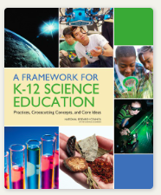
what & WHY
New Indiana Science (& CS) Standards that are based on recommendations in the NRC Framework for K-12 Science Education
Focus on inquiry, problem solving, storytelling, and phenomena instead of discrete facts and rote memorization.
Eliminates “teaching to the test”
3D instruction creates multiple access points for diverse student groups.
Shifts focus from rote memorization of scientific facts to actually doing science, students spend time posing questions, discovering answers, and evaluating them according to scientific principles.
Greater translation in knowledge by combining content with practice.
Notes:
Share in chat
Indiana science standards - https://www.in.gov/doe/students/indiana-academic-standards/science-and-computer-science/
The Framework - https://nap.nationalacademies.org/catalog/13165/a-framework-for-k-12-science-education-practices-crosscutting-concepts
Our new standards were adapted from the “Science Framework for K-12 Science Education” which provides the blueprint for developing the Next Generation Science Standards (NGSS). This framework provide a vision in science education that requires students to operate at the nexus of three dimensions of learning: Science and Engineering Practices, Crosscutting Concepts, and Disciplinary Core Ideas. The Framework identified a small number of disciplinary core ideas that all students should learn with increasing depth and sophistication, from kindergarten through grade twelve. Key to the vision expressed in the Framework is for students to learn these disciplinary core ideas in the context of science and engineering practices. The importance of combining science and engineering practices and disciplinary core ideas is stated in the Framework as follows: Standards and performance expectations that are aligned to the framework must take into account that students cannot fully understand scientific and engineering ideas without engaging in the practices of inquiry and the discourses by which such ideas are developed and refined. At the same time, they cannot learn or show competence in practices except in the context of specific content. (NRC Framework, 2012, p. 218).
The Framework specifies that each performance expectation must combine a relevant practice of science or engineering, with a core disciplinary idea and crosscutting concept, appropriate for students of the designated grade level. That guideline is perhaps the most significant way in which the NGSS differs from prior standards documents. In the future, science assessments will not assess students’ understanding of core ideas separately from their abilities to use the practices of science and engineering. They will be assessed together, showing students not only “know” science concepts; but also, students can use their understanding to investigate the natural world through the practices of science inquiry, or solve meaningful problems through the practices of engineering design. The Framework uses the term “practices,” rather than “science processes” or “inquiry” skills for a specific reason: We use the term “practices” instead of a term such as “skills” to emphasize that engaging in scientific investigation requires not only skill but also knowledge that is specific to each practice. (NRC Framework, 2012, p. 30).

Slide 9
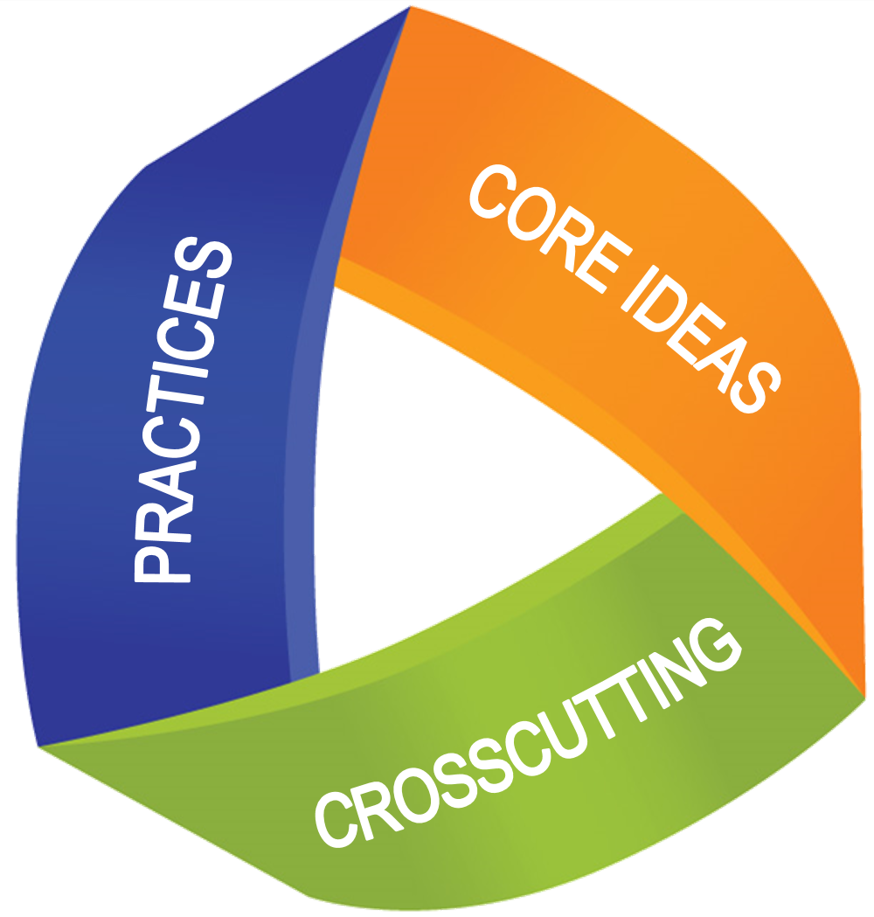
3D learning
Dimension 1: Practices
Dimension 2: Crosscutting Concepts
Dimension 3: Disciplinary Core Ideas
Notes:
Share in chat - https://www.nextgenscience.org/three-dimensions
Dimension 1: Practices
The practices describe behaviors that scientists engage in as they investigate and build models and theories about the natural world and the key set of engineering practices that engineers use as they design and build models and systems. The NRC uses the term practices instead of a term like “skills” to emphasize that engaging in scientific investigation requires not only skill but also knowledge that is specific to each practice. Part of the NRC’s intent is to better explain and extend what is meant by “inquiry” in science and the range of cognitive, social, and physical practices that it requires.
Although engineering design is similar to scientific inquiry, there are significant differences. For example, scientific inquiry involves the formulation of a question that can be answered through investigation, while engineering design involves the formulation of a problem that can be solved through design. Strengthening the engineering aspects of the Next Generation Science Standards will clarify for students the relevance of science, technology, engineering and mathematics (the four STEM fields) to everyday life.
Dimension 2: Crosscutting Concepts
Crosscutting concepts have application across all domains of science. As such, they are a way of linking the different domains of science. They include: Patterns, similarity, and diversity; Cause and effect; Scale, proportion and quantity; Systems and system models; Energy and matter; Structure and function; Stability and change. The Framework emphasizes that these concepts need to be made explicit for students because they provide an organizational schema for interrelating knowledge from various science fields into a coherent and scientifically-based view of the world.
Dimension 3: Disciplinary Core Ideas
Disciplinary core ideas have the power to focus K–12 science curriculum, instruction and assessments on the most important aspects of science. To be considered core, the ideas should meet at least two of the following criteria and ideally all four:
Have broad importance across multiple sciences or engineering disciplines or be a key organizing concept of a single discipline;
Provide a key tool for understanding or investigating more complex ideas and solving problems;
Relate to the interests and life experiences of students or be connected to societal or personal concerns that require scientific or technological knowledge;
Be teachable and learnable over multiple grades at increasing levels of depth and sophistication.
Disciplinary ideas are grouped in four domains: the physical sciences; the life sciences; the earth and space sciences; and engineering, technology and applications of science.

Slide 10
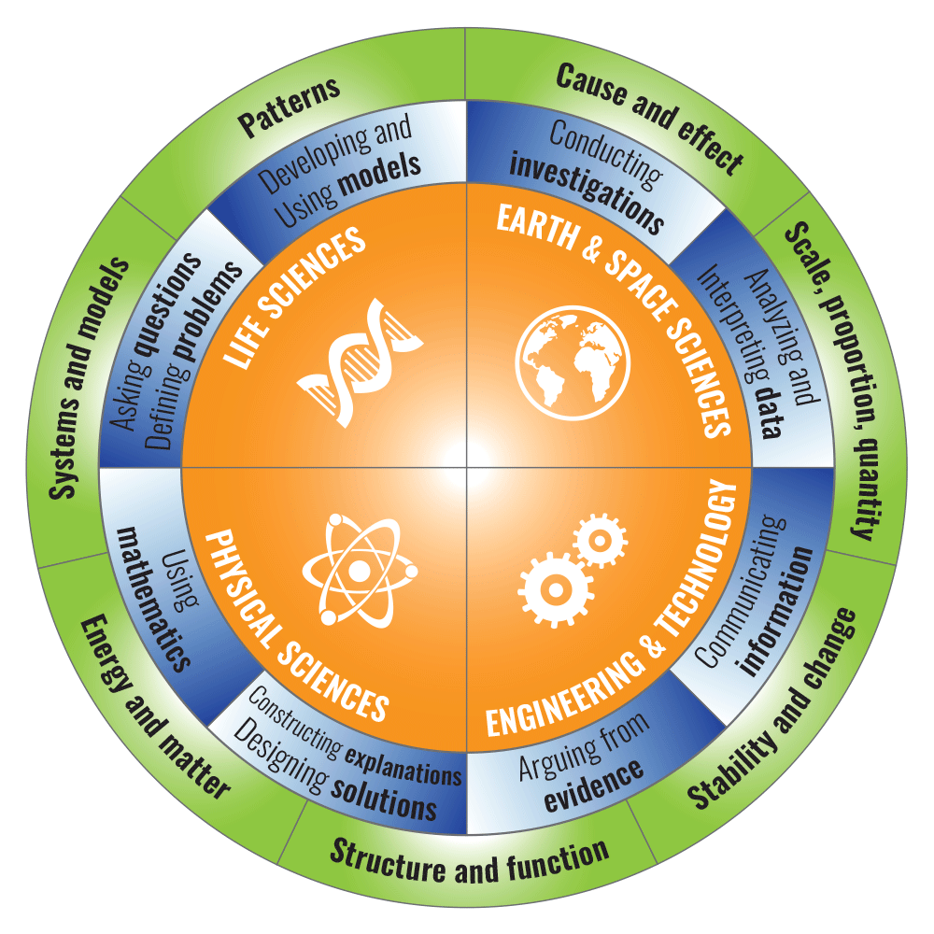
3D learning
Dimension 1: Practices (Blue)
Dimension 2: Crosscutting Concepts (Green)
Dimension 3: Disciplinary Core Ideas (Orange)
Notes:
Share in chat - https://www.nextgenscience.org/three-dimensions
Dimension 1: Practices
The practices describe behaviors that scientists engage in as they investigate and build models and theories about the natural world and the key set of engineering practices that engineers use as they design and build models and systems. The NRC uses the term practices instead of a term like “skills” to emphasize that engaging in scientific investigation requires not only skill but also knowledge that is specific to each practice. Part of the NRC’s intent is to better explain and extend what is meant by “inquiry” in science and the range of cognitive, social, and physical practices that it requires.
Although engineering design is similar to scientific inquiry, there are significant differences. For example, scientific inquiry involves the formulation of a question that can be answered through investigation, while engineering design involves the formulation of a problem that can be solved through design. Strengthening the engineering aspects of the Next Generation Science Standards will clarify for students the relevance of science, technology, engineering and mathematics (the four STEM fields) to everyday life.
Dimension 2: Crosscutting Concepts
Crosscutting concepts have application across all domains of science. As such, they are a way of linking the different domains of science. They include: Patterns, similarity, and diversity; Cause and effect; Scale, proportion and quantity; Systems and system models; Energy and matter; Structure and function; Stability and change. The Framework emphasizes that these concepts need to be made explicit for students because they provide an organizational schema for interrelating knowledge from various science fields into a coherent and scientifically-based view of the world.
Dimension 3: Disciplinary Core Ideas
Disciplinary core ideas have the power to focus K–12 science curriculum, instruction and assessments on the most important aspects of science. To be considered core, the ideas should meet at least two of the following criteria and ideally all four:
Have broad importance across multiple sciences or engineering disciplines or be a key organizing concept of a single discipline;
Provide a key tool for understanding or investigating more complex ideas and solving problems;
Relate to the interests and life experiences of students or be connected to societal or personal concerns that require scientific or technological knowledge;
Be teachable and learnable over multiple grades at increasing levels of depth and sophistication.
Disciplinary ideas are grouped in four domains: the physical sciences; the life sciences; the earth and space sciences; and engineering, technology and applications of science.

Slide 11
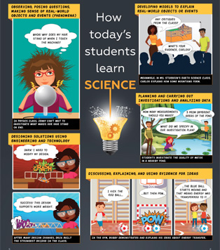
Friendly reminder
Science must be done throughout the year, every year, with ALL students!

Slide 12
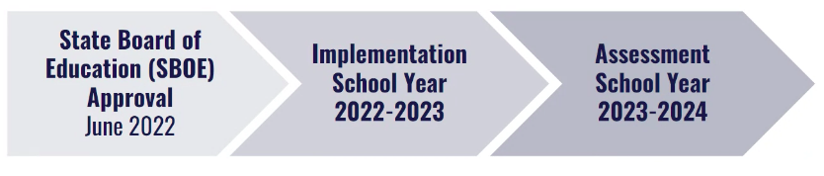
WHEN
Notes:
No, science assessment is currently not tied to your accountability. However, there is a lot of speculation about science assessment accountability changing in the future. So for those that may be thinking that implementation can wait, I encourage you to begin now. Not to mention the value add of these 3D science standards and what this can do for the problem solving and critical thinking skills as well as the increased engagement of your students.

Slide 13
WHERE can i find information & resources
IDOE webpage - Indiana Science & CS Standards
NGSS webpage
IDOE curated collections in the Learning Lab
Notes:
Check out the standards on the IDOE webpage. These have helpful resources such as correlation guides (2016 to 2022) & vertical articulation guides that illustrate the significant connections between the standards across grade levels. Administrators and teachers are strongly encouraged to use these documents to facilitate cross-grade level discussions.
IDOE standards - https://www.in.gov/doe/students/indiana-academic-standards/science-and-computer-science/
NGSS - https://www.nextgenscience.org/
NGSS resource library - https://www.nextgenscience.org/resource-library

Slide 14
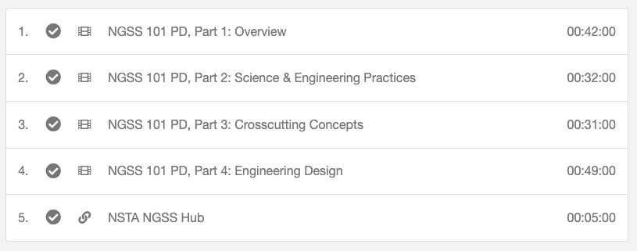
Ngss info
Notes:
Found in LL under: Continue learning with the 2022 Science Indiana Academic Standards
Put link in chat - https://inlearninglab.com/collections/continue-learning-with-2022-science-indiana-academic-standards

Slide 15
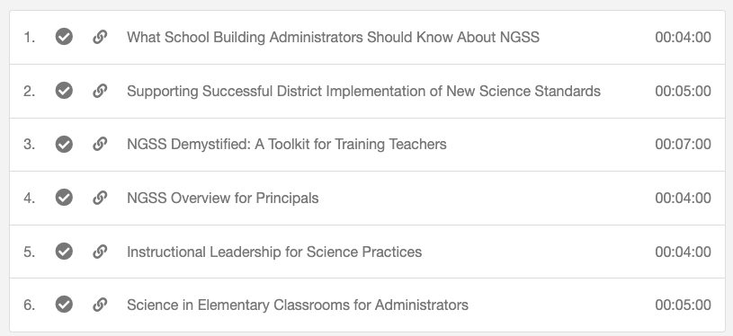
Building administration
Notes:
https://inlearninglab.com/collections/administrator-science-implementation-toolkit
Put link into chat
Admin - check out these 30 minutes of resources.

Slide 16
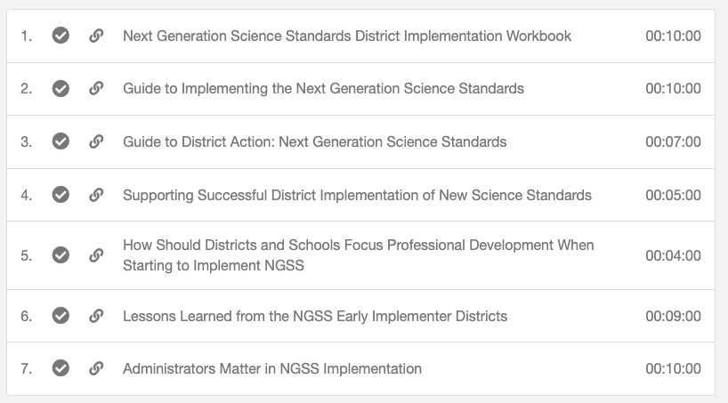
district administration
Notes:
https://inlearninglab.com/collections/district-level-science-science-implementation-toolkit
Put link into chat
About an hour of resources.

Slide 17
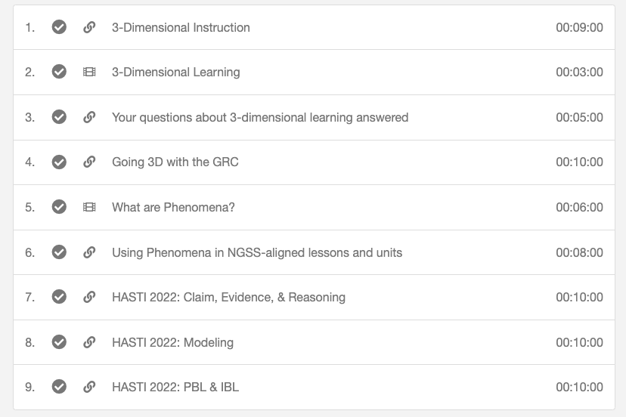
Teachers - Building background knowledge
Notes:
This collection features resources for teachers, instructional coaches, and administrators who are supporting the implementation of the Next Generation Science Standards (NGSS). Discover 3D learning, explore lessons, and see examples of phenomena.
1 hour and 11 minutes of content.
Go to link and demo
https://inlearninglab.com/collections/build-background-knowledge-about-2022-science-indiana-academic-standards

Slide 18
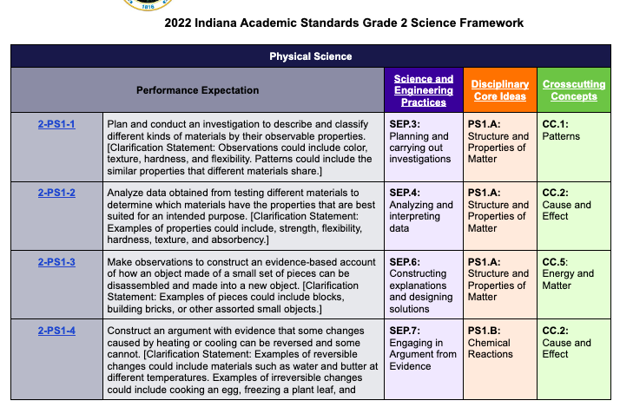
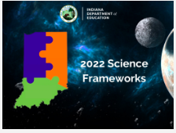
Teachers - 2022 Science frameworks
Notes:
This collection has a grade level framework for the Indiana Academic Standards and is designed to help educators in unpacking the standards, guiding best practices in instruction and turning the into learning opportunities for students! To view these frameworks, go to the link or pick the subject area, click on view this source, for more of a breakdown by standard, click on the standard. Then you can see things like: observable features, vocab, and example lessons.
Add link to chat & show live
2022 Science Frameworks

Slide 19
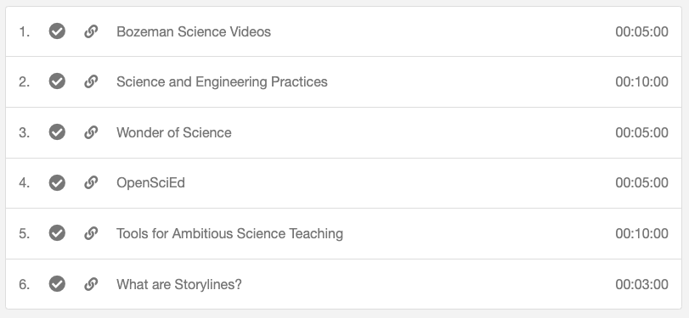
Teacher Resources
Notes:
Share link in chat -https://inlearninglab.com/collections/resources-to-teach-2022-science-indiana-academic-standards
Resources to teach 2022 Science Indiana Academic Standards

Slide 20
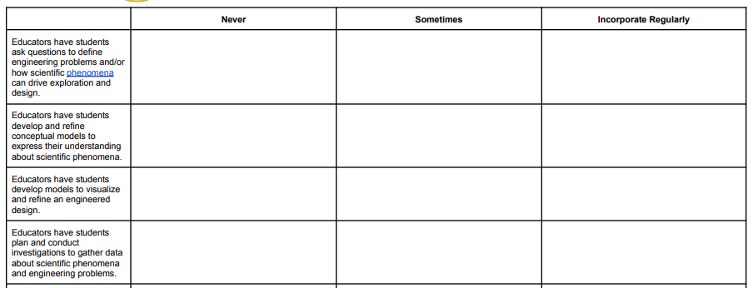
A survey of teacher understanding
Notes:
ADD LINK - for the three- part IDOE series in the learning lab addressing how to use these two tools to reflect on each component of three dimensional learning.
Share link - https://media.doe.in.gov/news/new-framework-of-science-education-survey-of-teacher-understanding.pdf
Survey of Teacher Understanding - This survey was designed as a reflection tool to gauge teachers’ knowledge of science and engineering practices, disciplinary core ideas, crosscutting concepts, and three-dimensional learning. These concepts are critical aspects of Indiana’s updated science standards, and this survey should be used as a guide to determine teacher readiness for implementation.
Thoughtful reflection on survey results can drive collaboration in professional learning communities (PLCs), inform decision-making about curriculum map transition timelines, and contribute to the development of action plans to implement the new science standards. School corporations are encouraged to use survey results to customize implementation timelines prior to spring 2024 assessment windows.

Slide 21
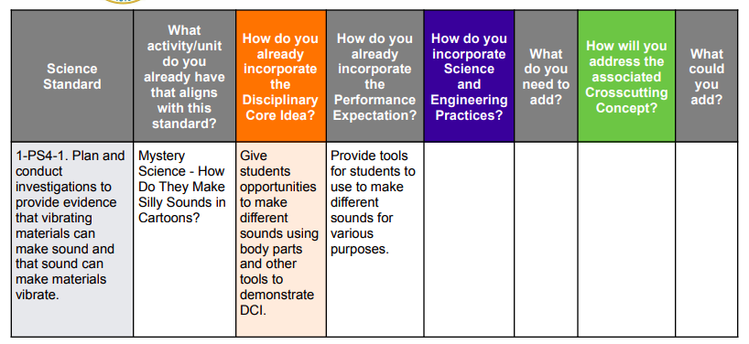
Curriculum map audit tool
Example responses:
Notes:
ADD LINK - for the three- part IDOE series in the learning lab addressing how to use these two tools to reflect on each component of three dimensional learning.
Share link in chat - https://media.doe.in.gov/news/k-12-science-curriculum-map-audit-tool.pdf
Curriculum Map Audit Tool - Updated science standards have created the need to audit current practices and determine what next steps are needed to align to the three-dimensional instructional approach for Indiana’s new science standards. IDOE has developed this curriculum auditing tool to allow teachers to examine their current science lessons and units to determine if or how they already align with newly adopted science standards. When used in conjunction with the Survey of Teacher Understanding, instructional leadership teams can identify areas in need of support while customizing an implementation timeline leading up to the assessment window in spring 2024.
An example of this implementation timeline can be found in Appendix A - ON NEXT SLIDE

Slide 22
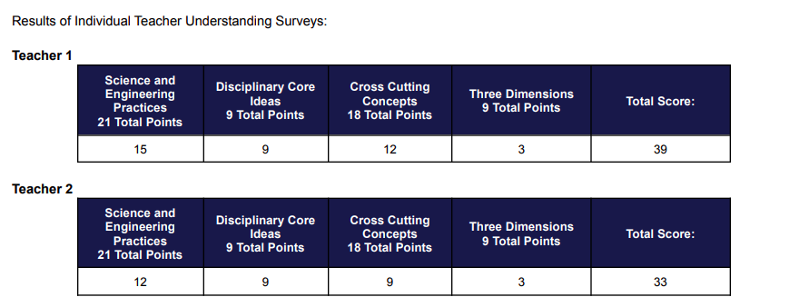
Curriculum map audit tool - appendix a
Notes:
See Appendix A for this EXAMPLE:
Here is an example scenario: A first grade team of educators is excited to get started with the new standards! Each teacher has individually completed the New Framework of Science Education Survey of Teacher Understanding. The team collaborated to identify lessons and units of study from their current curriculum map that align with performance expectations, disciplinary core ideas, crosscutting concepts, and science and engineering practices from the new science standards.
Possible Action Steps:
● Since survey results indicate that both teachers have opportunities to learn more about crosscutting concepts and science and engineering practices, investigating resources and participating in professional development may be a necessary part of implementing the new science standards fully.
● The curriculum map audit shows these teachers already have a strong starting point for 1-PS4-1. Adding science and engineering practices and crosscutting concepts to the previous lesson will align with the new standards.
● A goal for professional development and PLC work could be to improve in identifying opportunities to include crosscutting concepts for each unit the team agrees to try out in the 2022-2023 implementation year.

Slide 23
A CALL TO ACTION
ALL - Register in the Learning Lab & review resources
  https://inlearninglab.com/
District and Building Admin
  View Admin Science Toolkits in the Learning Lab
  Support teachers in creating an implementation timeline
Teachers
  Complete the Survey of Teacher Understanding
  Use the Science Curriculum Map Audit Tool to examine current science lessons and units to determine if or how they already align with newly adopted science standards. Then, identify areas in need of support while customizing an implementation timeline leading up to the assessment window in spring 2024.

Slide 24
We are here to support!
STEM Synergy Coordinator
Keep Indiana Learning
Amanda McCammon
amccammon@ciesc.org
www.KeepIndianaLearning.org
Twitter: @AMcCammon_
Notes:
Customized support packages available:
Unpacking the new science standards
Implementing in 3D

