Slide 1


The Road to STEM Certification: Using the Feedback to Build Your Evidence
Notes:
SS is the STEM leg of KInL. SS is a STEM-centric community of practice committed to fostering the delivery of data-informed services, including high-quality professional development, resources, and support for STEM-focused districts, programs, and organizations in an endeavor to produce a combined impact greater than the sum of separate STEM efforts.
STEM Synergy is a result of numerous partnerships over the years and is the latest iteration of the Indiana STEM Ecosystem.
Today we will be honing in on STEM Certification and using the feedback to build your evidence!

Slide 2

A Little About Me...
16 Years in Indiana Public Education
Former Teacher, Building Administrator, CTE Director, Student Services Coordinator, and Assistant Superintendent
Former IDOE Chief of Workforce & STEM Alliance
Current KInL STEM Synergy Coordinator & Indiana STEM Ecosystem Lead
Notes:
Over a 15 yrs serving at all levels in Indiana education
Technology education and PLTW teacher, building administrator, CTE Director, Student Services Director, and Assistant Superintendent.
Two years at the State level as the Chief of Workforce & STEM Alliances.
Led the charge from the General Assembly in 2017 to develop a 6 year State-wide STEM strategic plan outlining Indiana's objectives for STEM education.
Served across the nation as an educational consultant working toward equitable, high quality STEM for all. Amanda also serves as the Indiana STEM Ecosystem Lead and STEM Synergy Coordinator for CIESC/Keep Indiana Learning.

Slide 3

What school’s do we have here today?
Notes:
In the chat list your school and “current” if you are a current applicant or “future” if you are just getting info for next year…if you are here for neither of those reasons, you can just type “I’m lost” or another reason…lol

Slide 4
Today’s Learning Outcomes
By the end of the session I will….
...better understand our unique STEM Certification application feedback.
…have identified tools and insight that will assist my team in building the evidence to improve our chances at earning full STEM Certification.
Notes:
This session that will take a look into real-life feedback from the IDOE to applicants for STEM Certification. This session will assist teams in better understanding their unique feedback while providing you insight that will improve your chances at earning full STEM Certification.

Slide 5
The Series…
Your Application Questions Answered by IDOE Finalizing and Submitting Your Application - Open Help Sessions Using the Feedback to Build Your Evidence Preparing for Your Site Visit Learning from Each Other Showcase of schools Announcing & Using Your Status Getting Buy-In 2022-23 Application Review
Notes:
This session is one of many within the Road to STEM Certification Series and is intended to provide “just in time” support for schools that have recently applied to the IDOE for STEM Certification but will also provide future insight for those schools looking to apply in the future.
Your Application Questions Answered by IDOE - was recorded live October 6, 2021 & Coming in August 2022 Live
Finalizing and Submitting Your Application - Open Help Sessions - October 2021 (Coming in September 2022)
Using the Feedback to Build Your Evidence - (Live) December 14, 2021
Preparing for Your Site Visit (On Demand) - Coming in February 2022
Learning from Each Other Showcase of schools (On Demand) - Coming in March 2022
Announcing & Using Your Status (On Demand) - Coming in May 2022
Getting Buy-In (On Demand) - Coming in May 2022
2022-23 Application Review (On Demand) - Coming in June 2022

Slide 6

MOST IMPORTANTLY…..
Do not be discouraged by these scores - there are ABSOLUTELY some applicants that clearly deserve to earn full certification, just tighten it up!
Notes:
Before we get started…..
I have not seen your applications OR your preliminary scores. I do not even know who has applied.
I have met with IDOE to discuss what trends they are seeing in the applications, common areas for improvement, and recommendations for edits to improve scores.
The recommendations we will discuss today are from this conversation. Not general recommendations, but specific to this round of applicants. Now, if you are on the call or viewing the on demand session, this information is still pertinent to your future application. It is just VERY much JUST IN TIME info for the 36 applicants from this year.

Slide 7
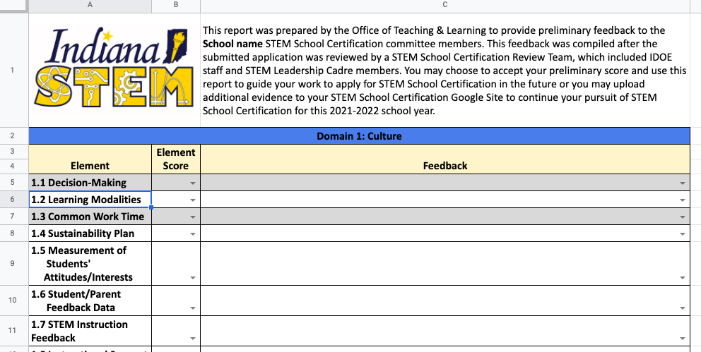
What You Have Received…Preliminary Score Report Template
Notes:
PUT IN CHAT - https://docs.google.com/spreadsheets/d/1MvvOOEpIlCyrjL6lcyj5a2BOzjdvUxVPgHt92b3MSBU/edit#gid=0
Friday, you should have received from the IDOE, your preliminary score report.
The individual feedback given in the spreadsheet - under feedback pulldown….if there was SPECIFIC feedback given by the reviewers on that element, it is being added here. Not just the option under the already populated pull down option.
Drop downs are general - but they are giving direct reviewer feedback in the docs. POINT THIS OUT!

Slide 8
Biggest Issues/Main Takeaways…
Following the rubric is the biggest issue
Lots of indirect evidence or reasoning
  Everything needs to be linked to the rubric
Evidence and narrative provided is not STEM focused
Notes:
We are going to dive into the rubric and more of the specifics to hone in on.

Slide 9
FIRST: Make Sure You Have Included ALL Required Components of the Application….
● STEM Plan Executive Summary (Maximum of 1,500 Words)
● STEM Plan Vision Statement
● STEM Plan Mission Statement
● STEM School Leadership Team Biographies
● STEM School Leadership Team Chair Contact Information
● Principal Information & Superintendent Information
● A Section For EACH Domain
○ Domain summary (Maximum of 500 Words)
○ Short summary and description of each piece of evidence
○ Corresponding, uploaded documentation
● 3 Letters of Support (Principal, Superintendent, & Community Partner)
Notes:
Before we dive into the parts of the rubric that many need to clean up….you first need to make sure you have all the required sections!
FIRST: Make sure you have ALL Required section components - MANY ARE MISSING on applications

Slide 10
SECOND: GO BACK TO THE RUBRIC
Prioritize!!! Do not hyper focus on areas not needing your attention or that you cannot impact in the given timeframe.
Start with the EE’s
  If you scored below a 3, you MUST fix it
Move to the other elements after you clean up the EE’s
Make sure you have met the REQUIRED evidence
If you include additional evidence, make sure you are presenting it through a STEM lens
Notes:
Following the rubric is the biggest issue!
Depending on how much you have to adjust from the feedback you just received, you may only have time to work on the EE’s (Essential Elements, you must score 3 on all of these). PRIORITIZE! Resubmit is due Jan 14th.
Required evidence pieces are missing
Ex: Continuous learning plan
Give everything through a STEM lens - all through STEM lens
For example - provide meeting minutes (should be STEM focused)
Training provided - through STEM lens
High schools tend to struggle with this….because it is a single program - still have to find a way to meet it
Tightening it up overall
If you provide something there should be a DIRECT reason and it should be EXPLICITLY linked to the rubric. See it all through STEM lens!

Slide 11
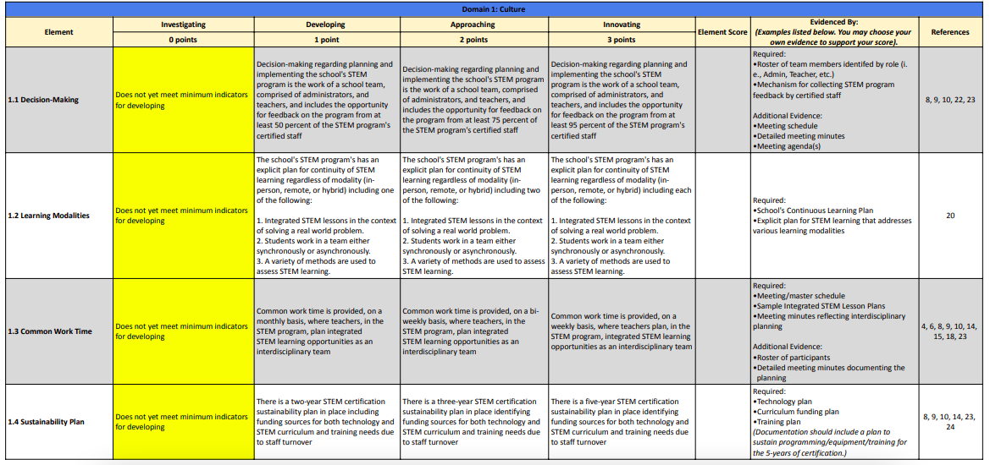
Notes:
PUT INTO THE COMMENTS - https://content.govdelivery.com/attachments/INDOE/2021/06/22/file_attachments/1860588/STEM%20Certification%20Evaluation%20Rubric%202021-2022%20%282%29.pdf
Let’s look at some elements that have common issues….
Element 1.2 - Learning modalities - continuous learning plan is required here, many provided it but there is nothing about STEM in the plan!
This is not an EE - so you do not have to get a 3 here. If there is nothing in your continuous learning plan about STEM, you likely cannot change that in the next 4 weeks and over the holiday break! So, this is probably not somewhere to prioritize now! Work on this later…but note it! You may be able to get STEM into your continuous learning plan before your site visit!
Many are not mentioning the 3 criteria outlined in this section. Be explicit in your continuous learning plan and in this application!
Element 1.3 Common work time - what are you working on together/creating that is STEM focused - add to your narrative and show evidence of this
Element 2.1 Curriculum integration - what is the research behind it and why you chose this curriculum based on research
Element 3.3 Student Instructional Workgroups - The metric being used is the issue and can easily boost you 2-3 points. Lots marked down based on metrics alone.
If you say a percentage - show this and be explicit - provide supporting documentation and narrative to explain

Slide 12
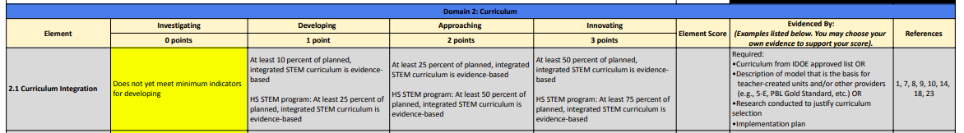
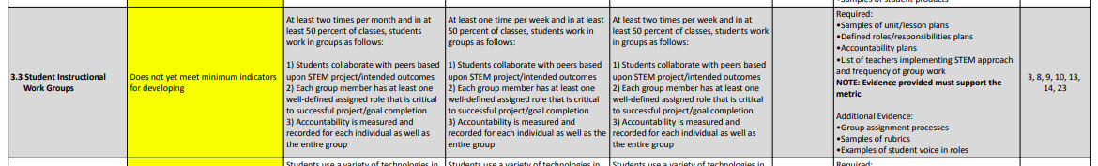
Notes:
Let’s look at some elements that have common issues….
Element 1.2 - Learning modalities - continuous learning plan is required here, many provided it but there is nothing about STEM in the plan!
This is not an EE - so you do not have to get a 3 here. If there is nothing in your continuous learning plan about STEM, you likely cannot change that in the next 4 weeks and over the holiday break! So, this is probably not somewhere to prioritize now! Work on this later…but note it! You may be able to get STEM into your continuous learning plan before your site visit!
Many are not mentioning the 3 criteria outlined in this section. Be explicit in your continuous learning plan and in this application!
Element 1.3 Common work time - what are you working on together/creating that is STEM focused - add to your narrative and show evidence of this
Element 2.1 Curriculum integration - what is the research behind it and why you chose this curriculum based on research
Element 3.3 Student Instructional Workgroups - The metric being used is the issue and can easily boost you 2-3 points. Lots marked down based on metrics alone.
If you say a percentage - show this and be explicit - provide supporting documentation and narrative to explain

Slide 13

Your Next Steps to Resubmit (by Jan. 14th)
STEM School Certification/Recertification Additional Evidence Report Submission Form
STEM School Certification Additional Evidence Report
Notes:
Applications scoring a minimum of 57 points and attaining a required score of three on all nine Essential Elements after rescoring will be contacted to schedule a site visit. Submissions scoring fewer than 57 points will receive feedback on the final score report and will not receive a site visit.

Slide 14

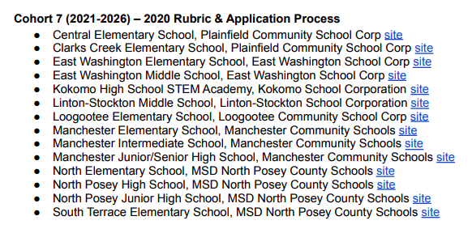
Check Out Previous Cohorts Sites
Notes:
ADD TO CHAT - https://content.govdelivery.com/attachments/INDOE/2021/06/24/file_attachments/1862452/STEM%20Certified%20Schools.pdf
I recommend looking at cohort 7’s sites to see how they looked at everything through a STEM lens and connected it all back to the rubric. Each site has their executive summary, vision/mission…but most helpful is the evidence.

Slide 15

Timeline REMINDERS:
Schools provide additional evidence by January 14, 2022
Feedback provided to schools from IDOE by February 4, 2022
Site visits completed by April 15, 2022
Official announcement of STEM Certified Schools by May 6, 2022

Slide 16
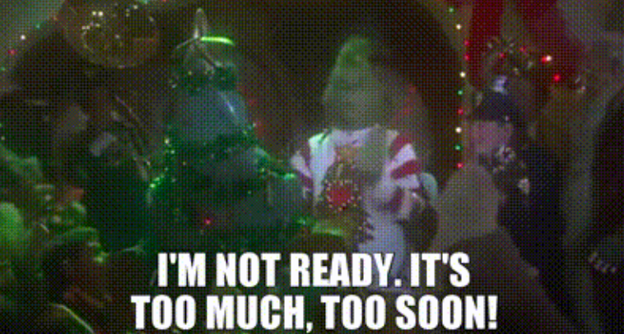
Too much too soon?
Just keep going for next year!
Use this as a stepping stone to move forward!

Slide 17
THANK YOU!!
STEM Synergy Coordinator
Keep Indiana Learning
Amanda McCammon
amccammon@ciesc.org
www.KeepIndianaLearning.org
Twitter: @AMcCammon_
Notes:
Need More Individualized Support? Reach out!
If time allows….invite applicants to jump on a zoom, where I can create breakout rooms for individual teams to have discussion with me around their unique feedback.
Join Zoom Meeting
https://ciesc-org.zoom.us/j/94904098296

