Slide 1

More Than Sand and Water
Presented by Angielena Williams and Kristin Parisi

Slide 2
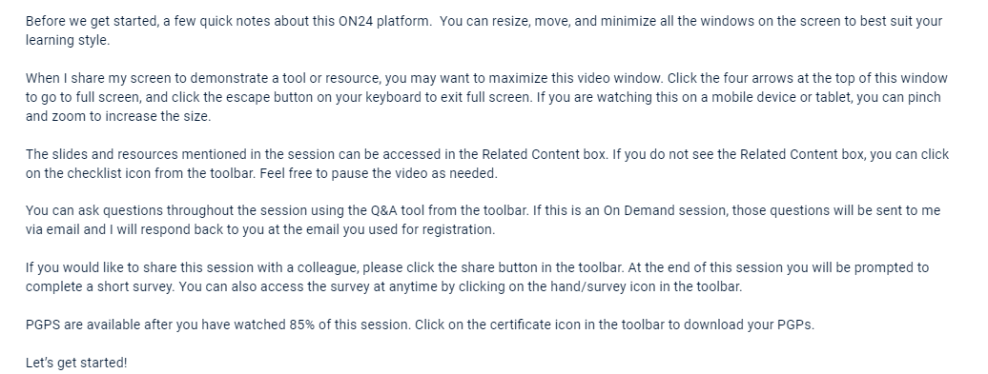


Slide 3

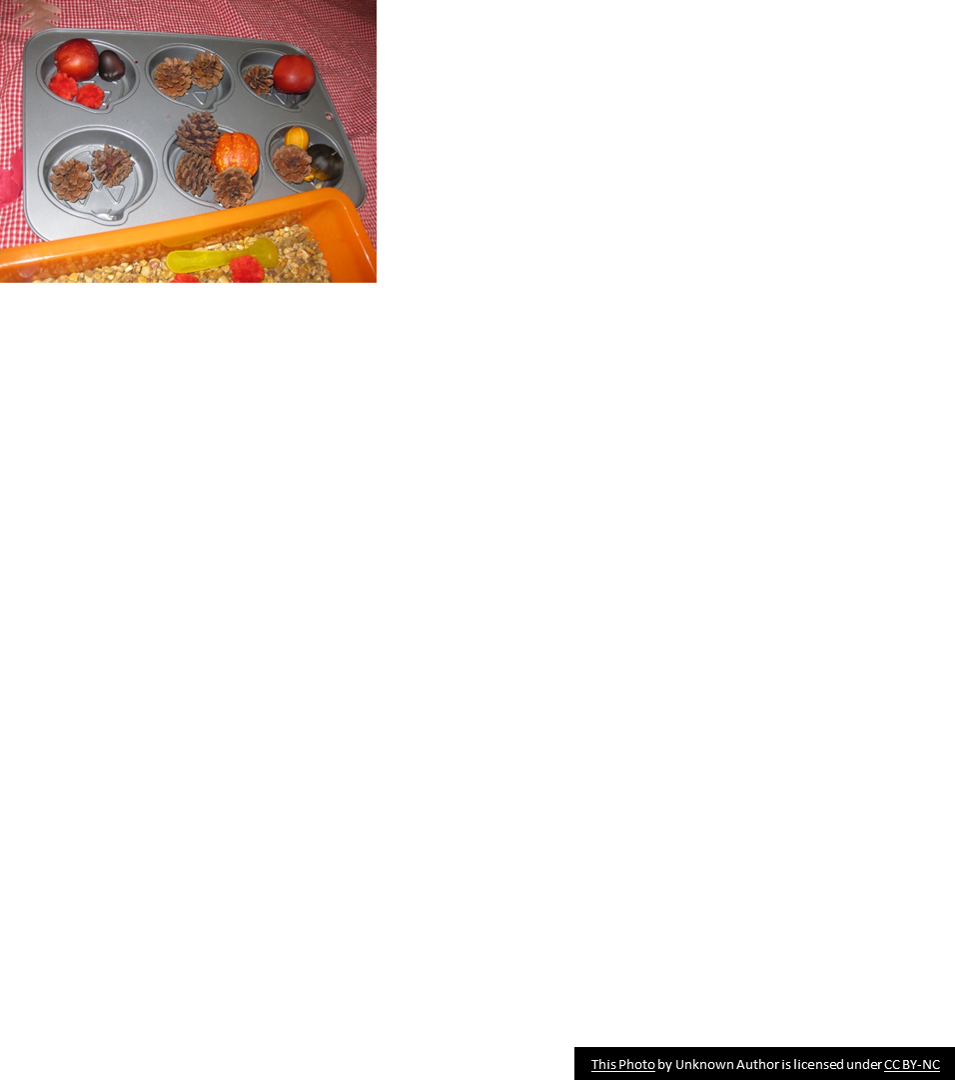
Sensory Play
What is Sensory Play?
Sensory play is any activity that stimulates a child’s senses. This could be hearing, sight, touch, smell or taste. It also includes play that involves movement or balance.
What Age Can You Start Sensory Play?
From the moment they’re born, your baby is ready for sensory play.
Even in the womb, your baby uses their senses to understand the world. By the time they are born, they’ll already be able to recognize your voice and your smell.
https://www.bbc.co.uk/tiny-happy-people/what-is-sensory-play

Slide 4
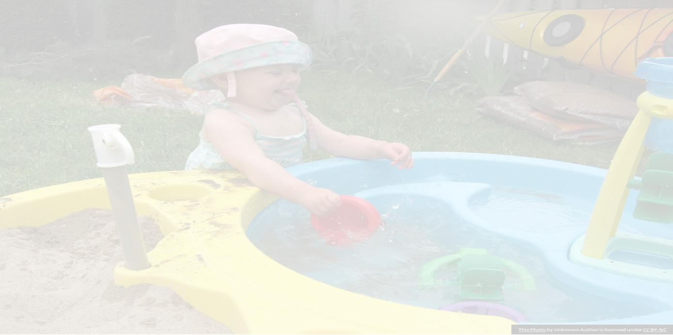
Sensory Play cont’d
As young children move their bodies, they learn many concepts through their senses (sensory motor integration).
Children should be provided with many experiences that integrate their body movements with their senses, including:
tactile/touch, smell, hearing, taste, sight, kinesthesia (movement), and the vestibular sense (found in the inner ear, this helps maintain balance and judge a person’s position in space).
Young children need experiences that stimulate the
inner ear’s vestibular area (e.g. as rocking, swinging, rolling, turning upside down, and spinning).
https://www.in.gov/doe/files/foundations-2015-august-12.pdf

Slide 5
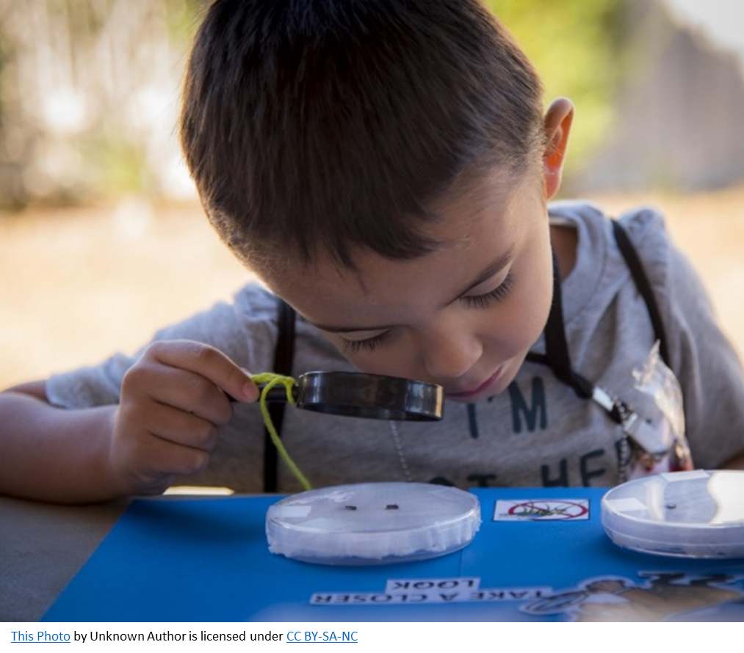
Benefits
-cause and effect
-discover which senses are more calming for their own selves
-attention span
-trying new things
-early intervention
-language learning
-social/emotional development

Slide 6

Characteristics of Sensory Play
Tactile
Vestibular
Proprioception
Auditory
Visual
Olfactory and Taste
Gustatory

Slide 7


In the Classroom
Vestibular
Proprioception
Tactile
Visual
Auditory
Olfactory
Gustatory
Rocking chair, inverting the head
Push ups, bear hugs, heavy work
Sensory bin, shaving cream, water beads, kinetic sand
Holiday lights, light covers
Headphones, quiet work spaces
Scented stickers, lotion, scented markers
Bubbles, chewable jewelry

Slide 8
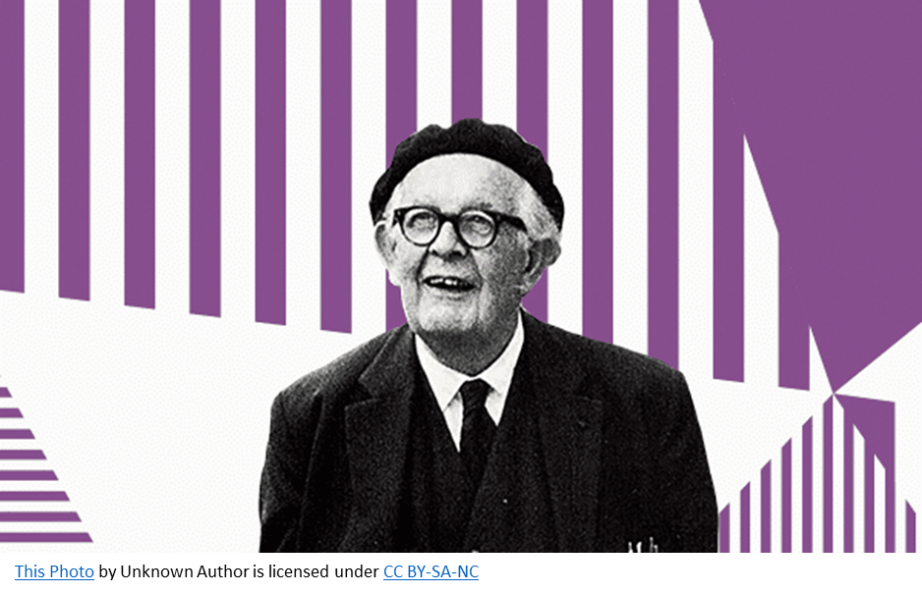
Jean Piaget
Jean Piaget is somewhat of a celebrity when it comes to developmental psychology. He was perhaps the first theorist of sensory play, suggesting that there was more to “play” than we understood. His theory of play (also known as developmental stage theory) states that play involves a systematic process of learning that can even be identified by stages. Piaget proposed that children need environmental stimuli and experiences to guide their cognitive development. Through sensory play, he suggested that children digest new knowledge and store it for later reference. In essence, he argued that this type of play was key to a child’s brain development.
https://www.oac.edu.au/news-views/sensory-play/

Slide 9


Slide 10
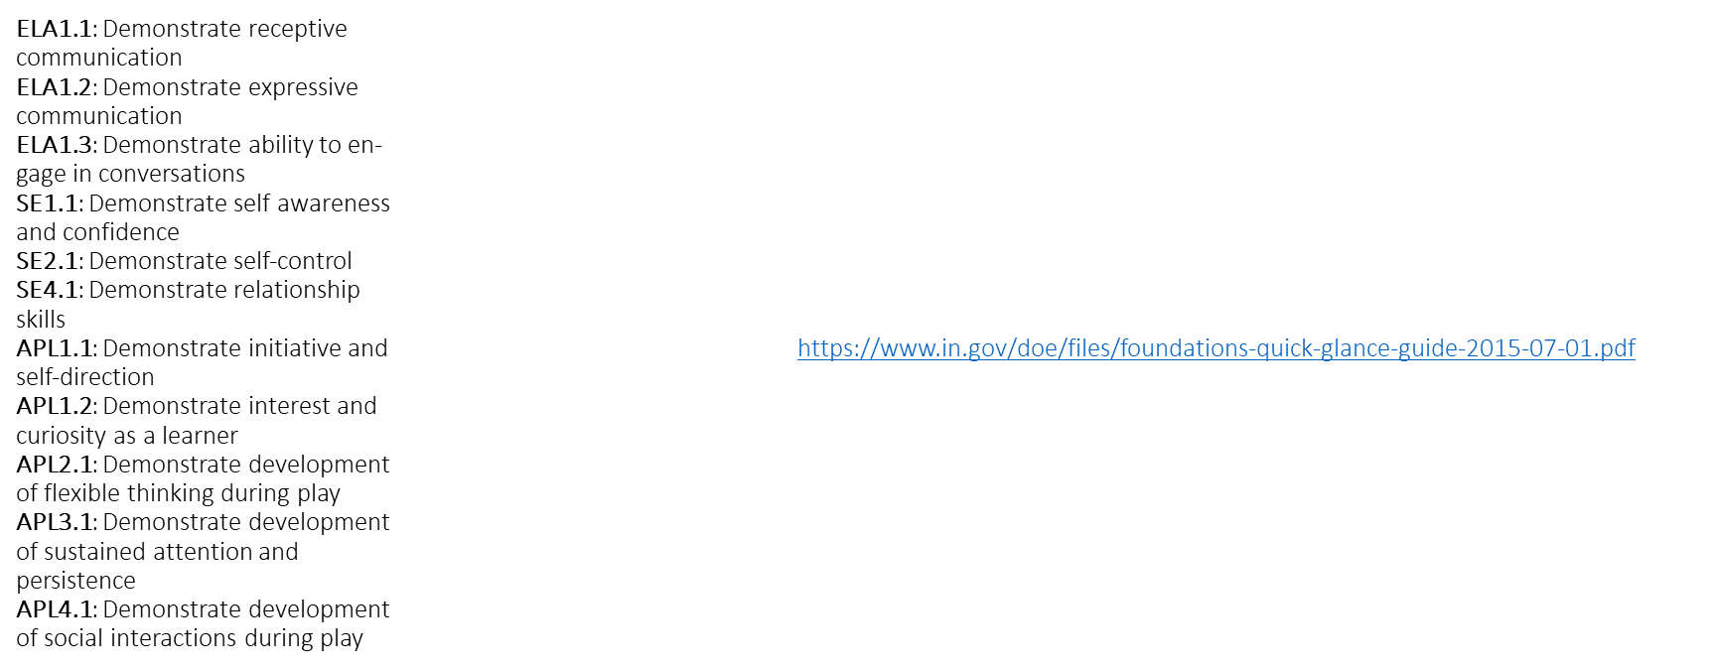
Relative Indiana Early Learning Foundations

Slide 11
Characteristics of Sensory Seekers
Poor transitions from one activity to another
Inability to sit at circle time in a defined space
Eloping or fleeing
Struggling to “settle down’
Fidgety
Seeking movement
Bite, suck, chew, mouth nonfood items
Poor motor planning
Struggle with potty training
Exhibit impulsivity by moving quickly from one activity to another
Wilmot, Kerian, Wired Differently A Teacher’s Guide to Understanding Sensory Processing Challenges, 2020
Notes:
One bluebird does not make it spring…we are all sensory seekers at times. Behaviors are more frequent and for longer periods of time, their fuse gets shorter and shorter and can result in loss of instruction or social time in classrooms.

Slide 12
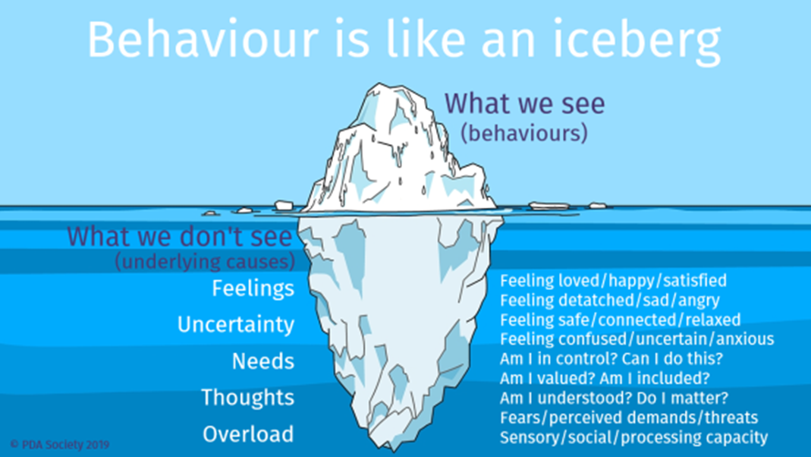
Managing Behaviors
Body awareness and tone
Use of touch
Environmental stimulation
Calming space
Empathy
Debrief

Slide 13
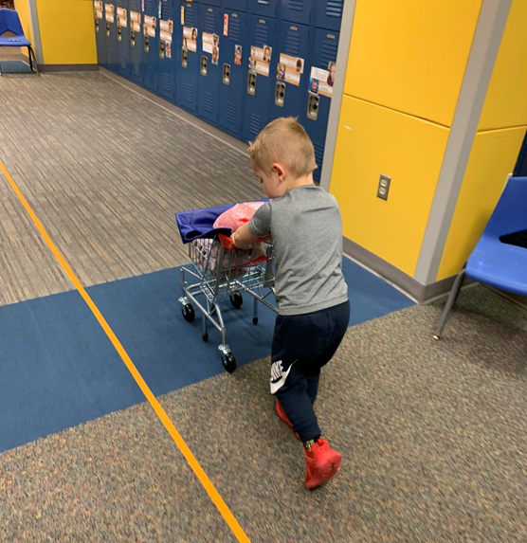
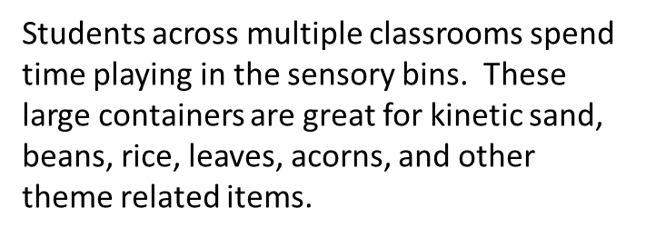
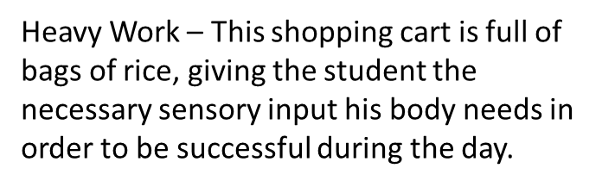


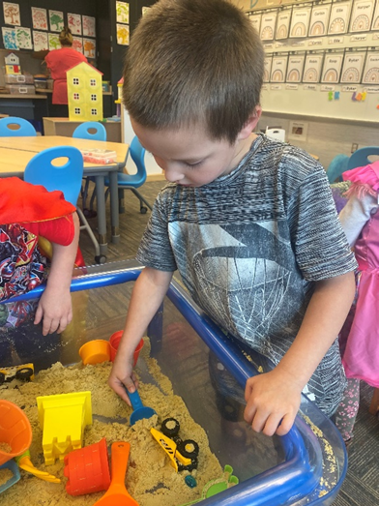
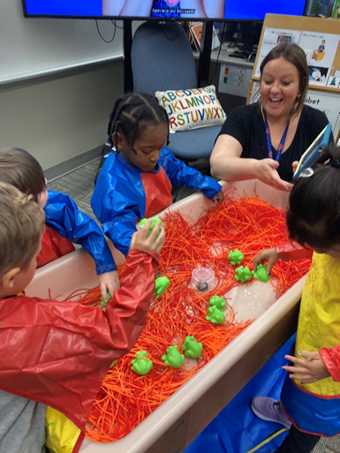
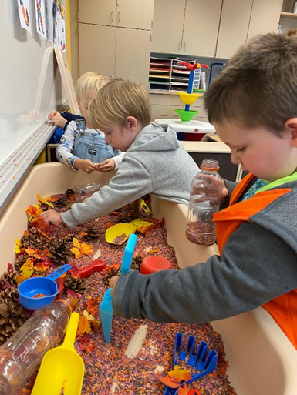
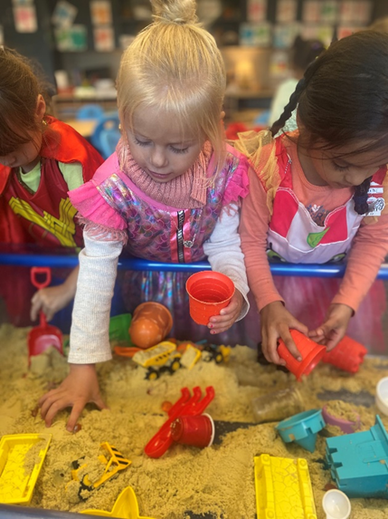

Slide 14
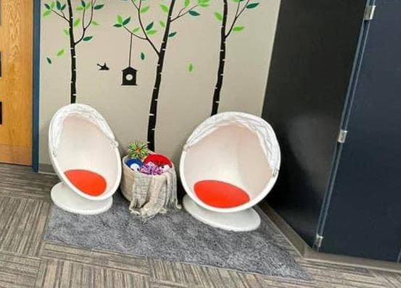

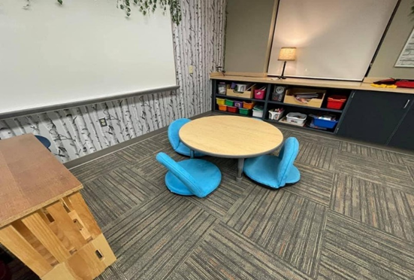
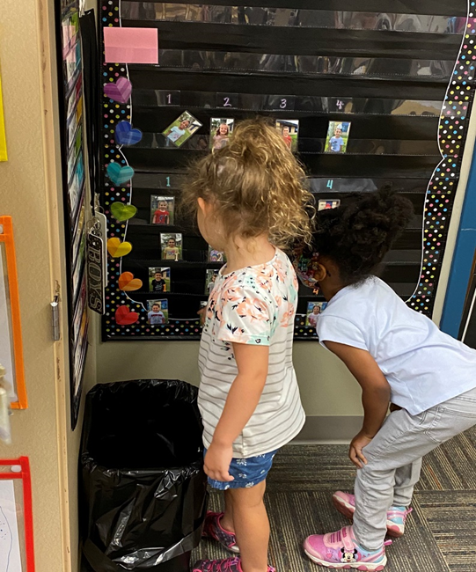
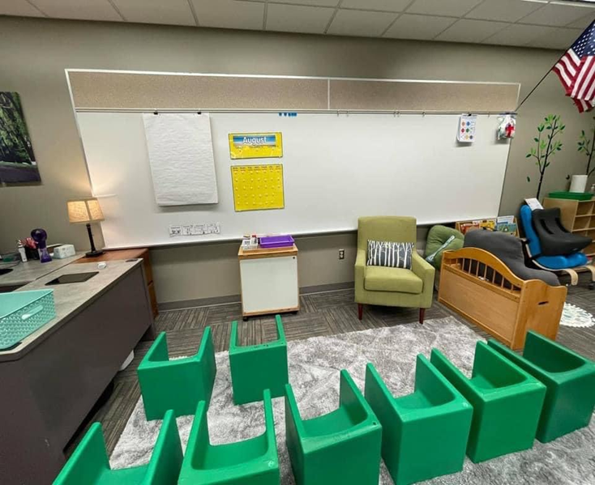

Slide 15

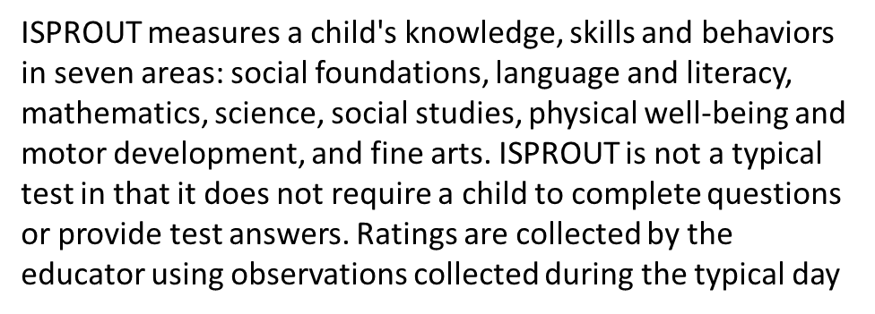


Slide 16
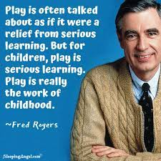
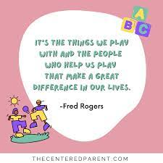
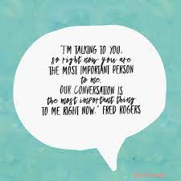

Slide 17


Angielena Williams
Angielena.Williams@fssa.in.gov
@AngielenaW
Kristin Parisi
KParisi@cpcsc.k12.in.us
@KristinParisi

