Slide 2
Take Control of your Learning Experience
ON24 Learning Platform:
All windows are resizable and moveable
Use the Related Content box to access slides and resources
Submit your questions using the Q&A
PGP certificates are available for download
Use the toolbar to access other features and bring back minimized tools.
Notes:
Hello and welcome to our session, TITLE OF THE SESSION. I am NAME, TITLE, ORG. Thank you for joining me/us at Keep Indiana Learning.
Before we get started, a few quick notes about this ON24 platform. You can resize, move, and minimize all the windows on the screen to best suit your learning style.
When I share my screen to demonstrate a tool or resource, you may want to maximize this video window. Click the four arrows at the top of this window to go to full screen, and click the escape button on your keyboard to exit full screen. If you are watching this on a mobile device or tablet, you can pinch and zoom to increase the size.
The slides and resources mentioned in the session can be accessed in the Related Content box. If you do not see the Related Content box, you can click on the checklist icon from the toolbar. Feel free to pause the video as needed.
You can ask questions throughout the session using the Q&A tool from the toolbar. If this is an On Demand session, those questions will be sent to me via email and I will respond back to you at the email you used for registration.
If you would like to share this session with a colleague, please click the share button in the toolbar. At the end of this session you will be prompted to complete a short survey. You can also access the survey at anytime by clicking on the hand/survey icon in the toolbar.
PGPS are available after you have watched 85% of this session. Click on the certificate icon in the toolbar to download your PGPs.
Let’s get started!

Slide 3
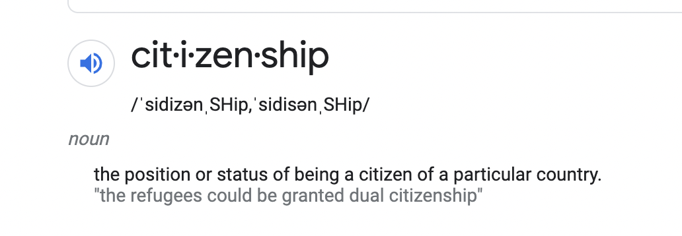
Creating a Sustainable Digital Future
screenshot from Google

Slide 4


Creating a Sustainable Digital Future
DIGITAL CITIZENSHIP
DIGITAL RESPONSIBILITY
Notes:
Icons from Noun project

Slide 5
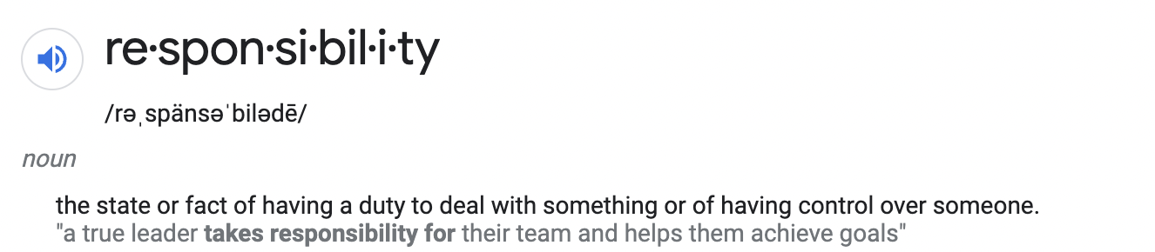
Creating a Sustainable Digital Future
screenshot from Google

Slide 6


Creating a Sustainable Digital Future
Notes:
Icons from Noun project

Slide 7


#1 - Create a Philosophy
Notes:
Icons from Noun project

Slide 8
#1 - Create a Philosophy
What type of technology is being used in your classroom?
How is technology used in your classroom?

Slide 9
#1 - Create a Philosophy
Do you use technology to...
to have student practices skills online
replace a hands-on lab activity with an online one
have students use the online textbook in class
implement new programs, apps, or websites
keep devices locked away

Slide 10
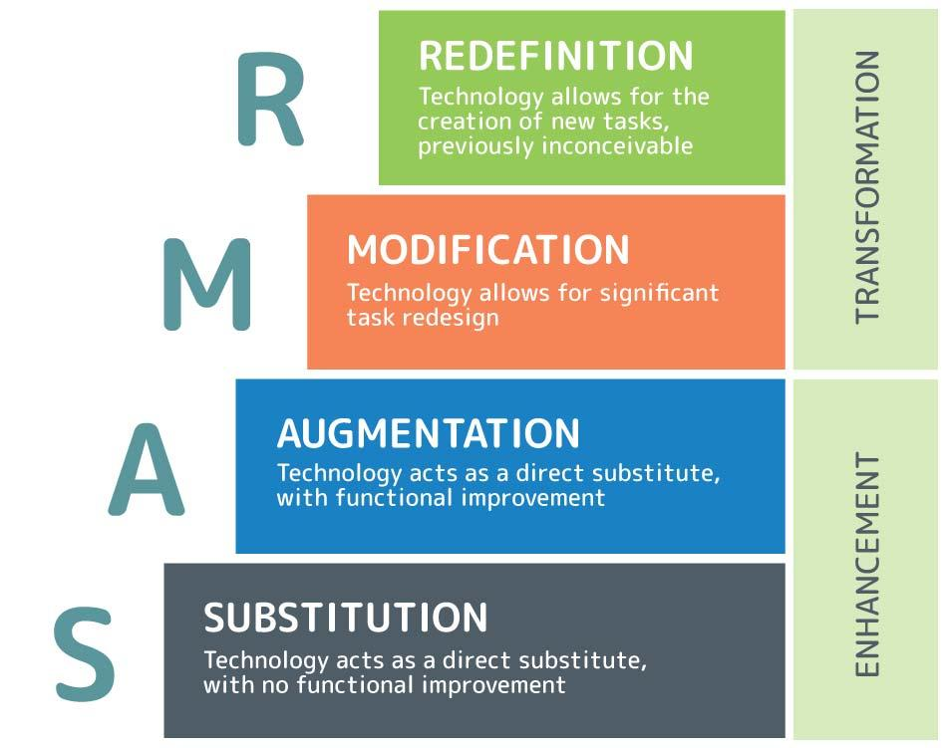
#1 - Create a Philosophy
Graphic by 3P Learning
Notes:
https://www.3plearning.com/blog/connectingsamrmodel/

Slide 11
#1 - Create a Philosophy
Ask yourself:
What am I wanting to accomplish?
How will this technology help create an obstacle free environment?
Why should I use this tool or device instead of paper?
Will my students know how to use or will I need time to teach them?
How can I model using positively?

Slide 12
#1 - Create a Philosophy
What is your philosophy on the use of technology in your classroom?

Slide 13
#1 - Create a Philosophy
All technology, no matter how large or small, will be used with purpose and intention in order to
make a positive impact,
create an obstacle free learning environment,
or to build a culture allowing students to become positive participants in our digital world.

Slide 14


#2 - Use Authentic Scenarios
Notes:
Icon for Noun project

Slide 15
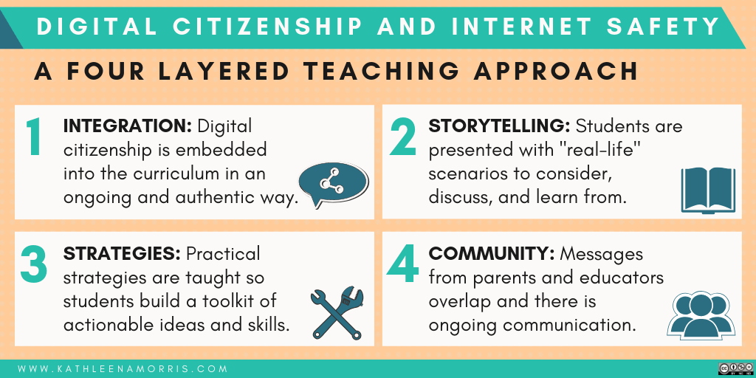
#2 - Use Authentic Scenarios
Graphic by Kathleen Morris
Notes:
https://www.kathleenamorris.com/2018/06/12/digital-footprints/

Slide 16
#2 - Use Authentic Scenarios
Teach students to be positive participants by
implementing real-life lessons
recognizing and praising positive digital behavior
creating a safe environment
understanding that we all get anxious

Slide 17


Student
Everyone
Notes:
Icons from Noun project

Slide 18
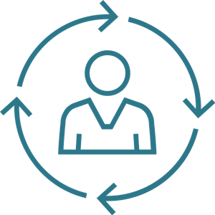

#3 - Model Positive Use
Notes:
Icons from Noun project

Slide 19
#3 - Model Positive Use
Technology is not the enemy!

Slide 20
#3 - Model Positive Use
Take Control:
Mute notifications
Set time limits
Download helpful tools
Set boundaries
Fully disconnect
Go positive - (@goodnewsmovement, @upworthy)
Center for Humane Technology
Notes:
https://www.humanetech.com/take-control

Slide 21
Create a sustainable digital future
#1 - Create a Philosophy
#2 - Use Authentic Scenarios
#3 - Model Positive Use
Center for Humane Technology
Notes:
https://www.humanetech.com/take-control

Slide 22
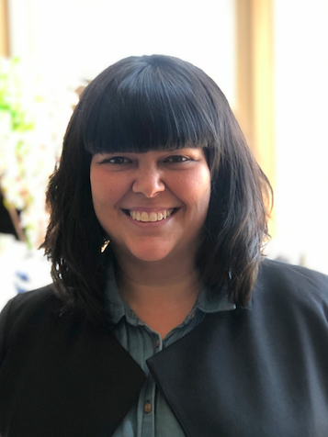
Kaylah Holland
@HollandKaylah
kholland@breakfree-ed.org

Slide 23
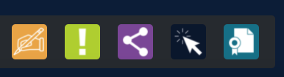
Thank you for attending!
Please complete the short feedback survey on the screen.
Don’t forget to download your PGP Certificate from the webcast toolbar.
Notes:
Make this the last slide in your presentation

