Slide 1


Reading Is
FUNdamental
Presentation by:
John (Jack) Hesser

Slide 2
Take Control of your Learning Experience
ON24 Learning Platform:
All windows are resizable and moveable
Use the Related Content box to access slides and resources
Submit your questions using the Q&A
PGP certificates are available for download
Use the toolbar to access other features and bring back minimized tools.

Slide 3
Reading Beyond English
Emphasizes real-world connection of reading comprehension
Builds deeper understanding of content knowledge
Students become more confident readers
  Help shift students from dependent to independent learners

Slide 4
Why is this Relevant?
We know that many students enter their secondary education not consistently reading on the appropriate grade-level.
There are a number of great resources and strategies we can implement to help students find success at the secondary level.

Slide 5
My Evolution
Incorporated content articles / textbook independently
Reading aloud grade-level articles / together
Small group leveled text, same content

Slide 6
Effective Use of Reading
Student Ownership
Classroom Experience

Slide 7
Student Ownership
Where is the student starting?
What is the student’s goal?
How will the student (and teacher) track their goal?

Slide 8
Starting Point
External or Internal Diagnostic
  NWEA, ILEARN, Lexile Screener, Achieve 3000, Imagine Reading
Analyze class trends
  Identify students who may require tier-3 interventions (high and low) – WAIT to act
Review the diagnostic with students 🡪 Tests are only a snapshot of performance on one day.

Slide 9
Grade | Approximate Lexile Band
4 | 740 - 940
5 | 830 - 1010
6 | 925 - 1070
7 | 970 - 1120
8 | 1010 - 1185
Georgia’s Department of Education
https://www.gadoe.org/Curriculum-Instruction-and-Assessment/Assessment/Pages/Lexile-Framework.aspx

Slide 10
Goal Setting
Students examine their diagnostic
  Acknowledge the limitations of diagnostic.
Establish the “Big” goal
  Think through what makes sense for your school

Slide 11
Goal Setting
Model what “typical” growth looks like
  If a student did just their classwork in English class, they’d like grow 1 grade level a year – is that what the student is aiming for?
Set the ”Intermediate” goal
  Where should the student be by the end of THIS TIME FRAME to be on track to their goal
  This will be the most frequently referenced data-point.

Slide 12
Tracking Growth
External Diagnostic?
Tracker Sheet OR Continuous Metric
  Student should engage with something (paper or electronically) whenever doing a strategic reading assignment to keep them focused on their goal.

Slide 13
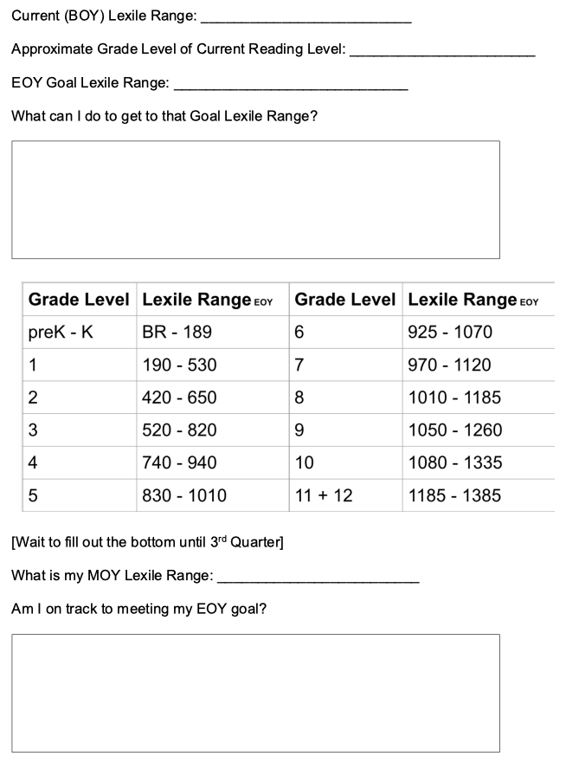
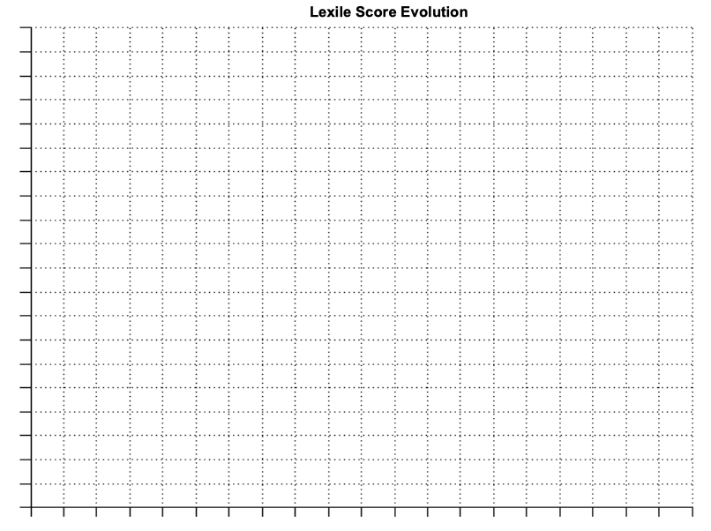
Tracking Growth

Slide 14
Classroom Experience
Who, what, when, where, why?

Slide 15
Who
Reading groups based on goals.
Academically monitor
  Eventually prioritize students who may need most support (utilize Science of Reading research)

Slide 16
What
Selecting texts
  Do you have required resources? (Achieve 3000, Lexia, NewsELA, Imagine Reading)
Activity
  You can use pre-selected questions, content-specific questions, OR a combination.
  I use content questions while students are in groups, and then reading-specific for the individual work.

Slide 17
When (frequency)
Identify standards-alignment
Predictability, preferred

Slide 18
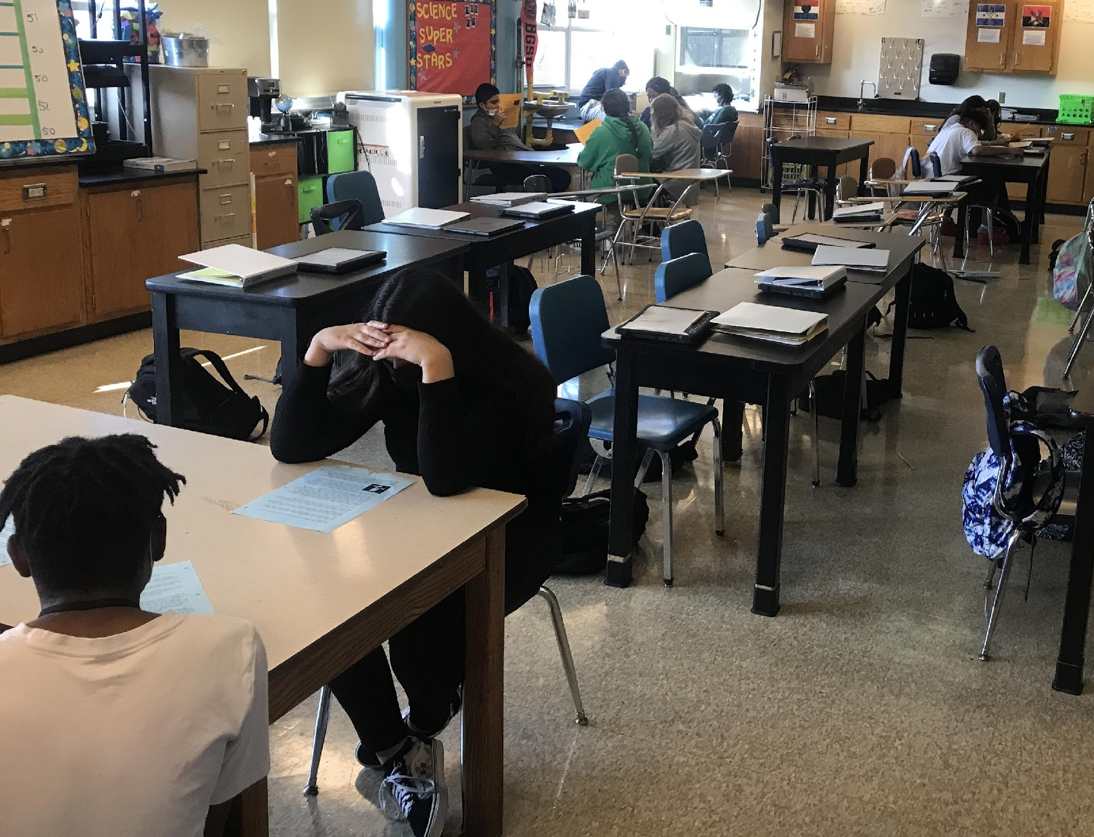
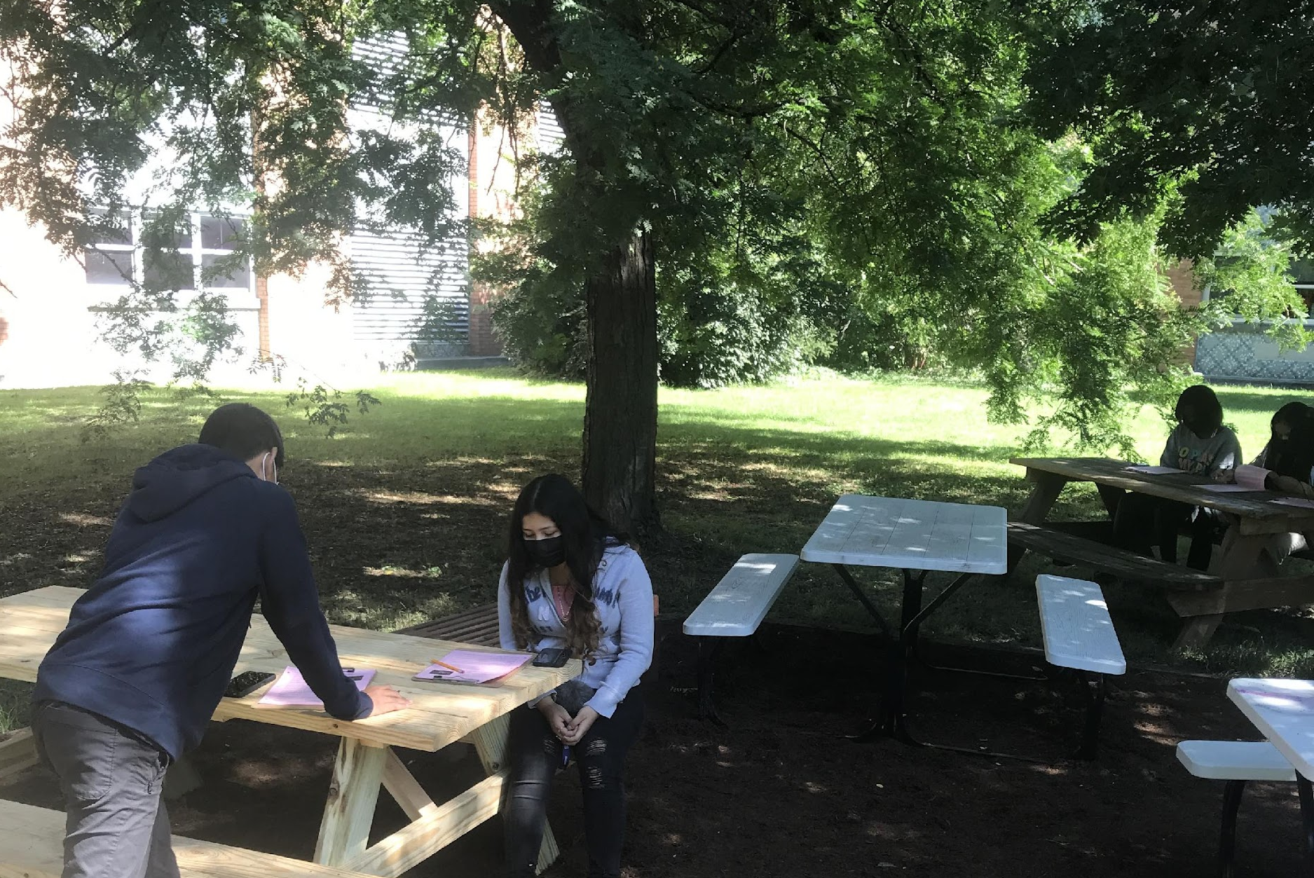
Where
Mix-up seating (safely)
Use the outdoors!

Slide 19
Why
Connect to student goals and “tracking.”
Reinforce how the skills they are using are transferable.

Slide 20
John (Jack) Hesser
@JackMcHair
Indianapolis Public Schools
hesserj@myips.org

